Slide 1
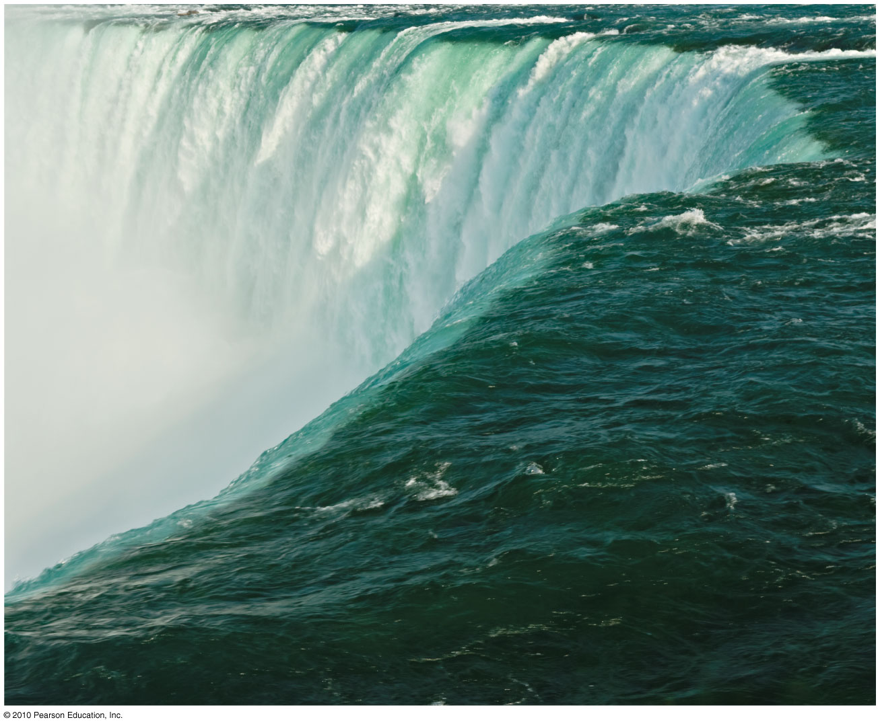
CHAPTER 11
RIVER SYSTEMS &
LANDFORMS

Slide 2
River Systems and Landforms
Fluvial Processes and Landscapes
dominant natural agent of landmass denudation
represents 0.003% of all freshwater
stream related processes – fluvial
driving forces of rivers – insolation and gravity
erosion, transportation & deposition
alluvium – clay, silt 7 sand transported by running water
Streamflow Characteristics
Floods and River Management

Slide 3
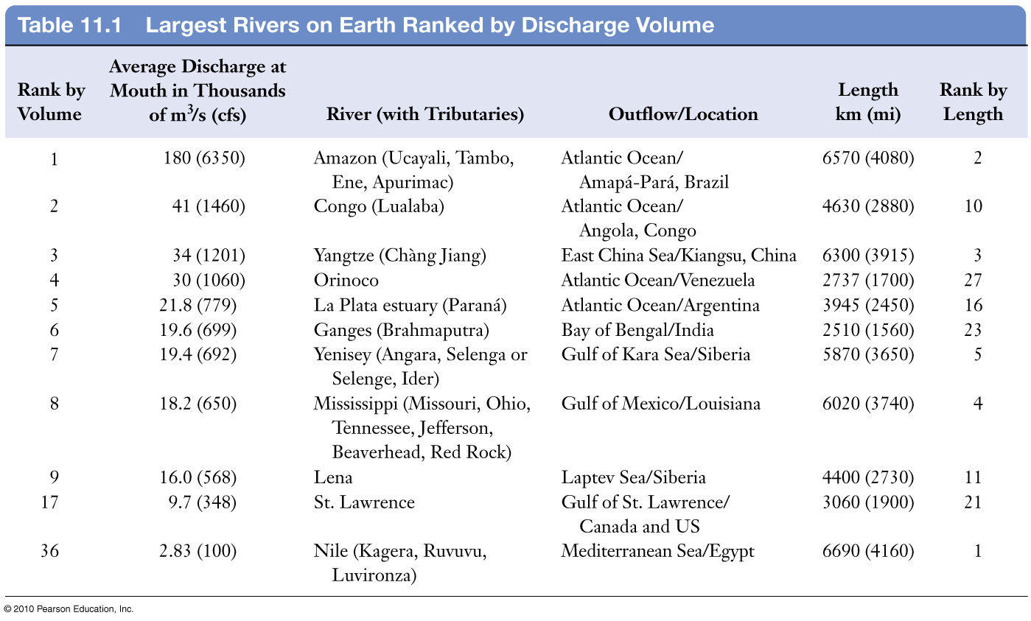

Slide 4
Fluvial Processes and Landscapes
Base Level of Streams
Is a level below which a stream cannot erode its valley
Ultimate base level is sea level
Local base level – natural (river, lake, hard and resistant rock structure), artificial (dam)
In arid landscapes; valleys, plains, other low point determine local base level
Initial landscapes
Sequential landscapes
The work of streams modifies landscapes, 2 processes produce landform:
Erosive action of running water
Deposition of stream-transported materials

Slide 5
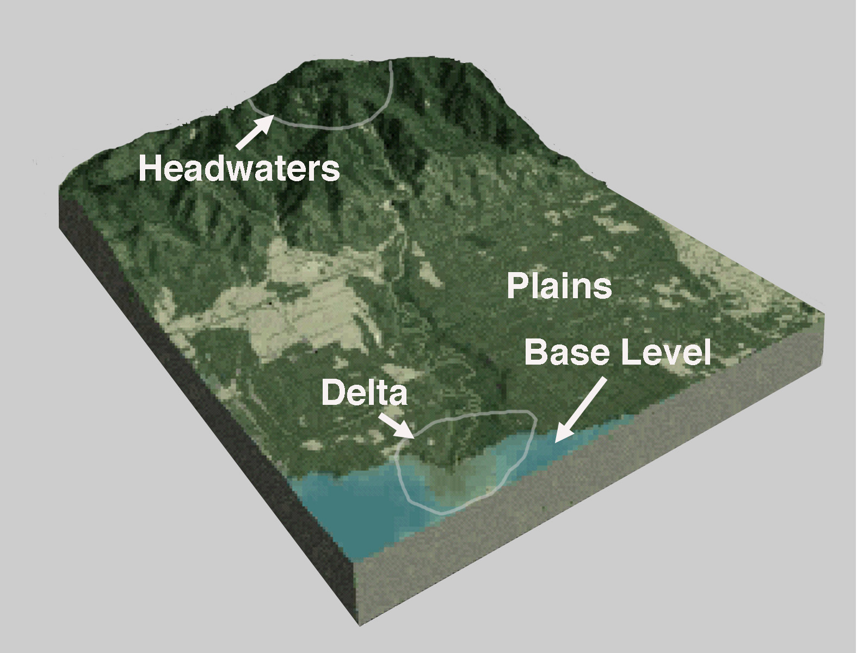
ANATOMY OF A RIVER

Slide 6
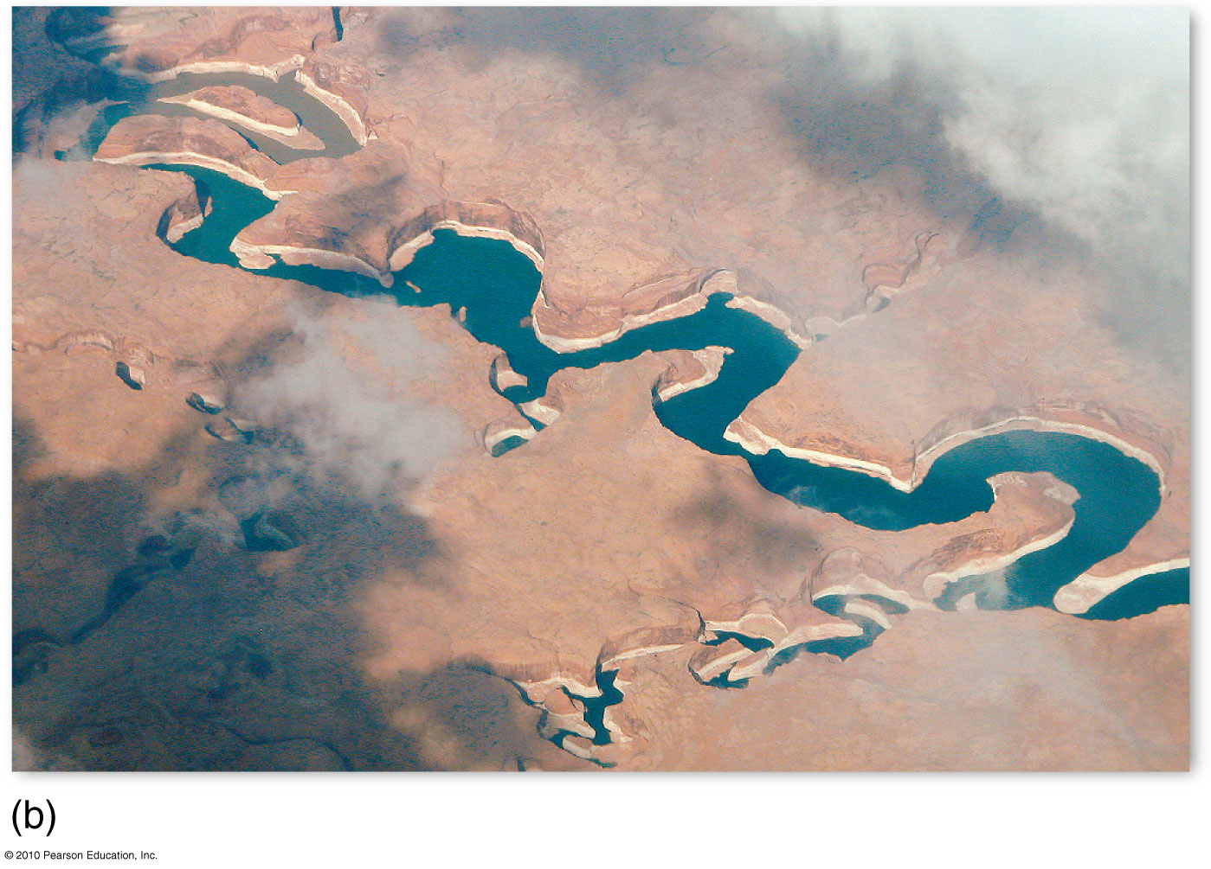
Powell’s Journey to Base Level
Figure 11.2b
Christopherson, Elemental Geosystems, Sixth Edition
Copyright © 2010 Pearson Education, Inc.

Slide 7
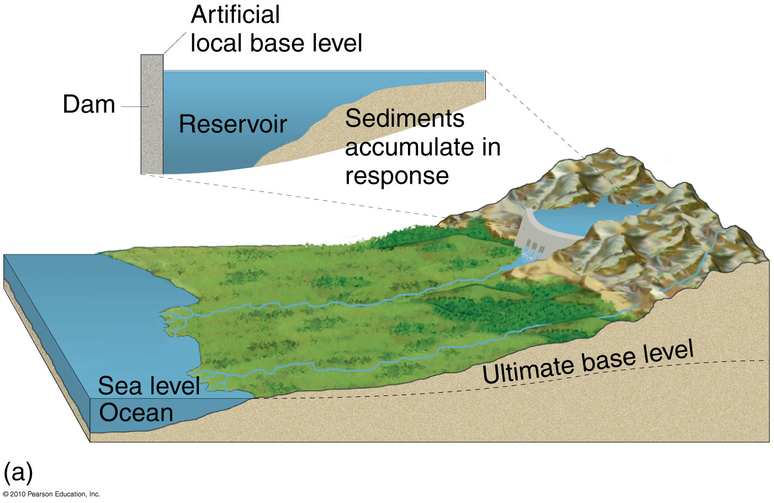
Ultimate and Local Base Levels
Figure 11.2
Christopherson, Elemental Geosystems, Sixth Edition
Copyright © 2010 Pearson Education, Inc.

Slide 8
Fluvial Processes and Landscapes
The Drainage Basin System
every stream has a drainage basin ranging in size
formed by ridges that define every drainage basin
catchment area of the drainage basin
Water moves downslope as sheetflow or overland flow
Interfluve – high ground that separates one valley from another, therefore directing sheetflow; ravine or gully
Surface runoffs concentrate in rills (small-scale grooves) or deeper channels, then into a stream

Slide 9
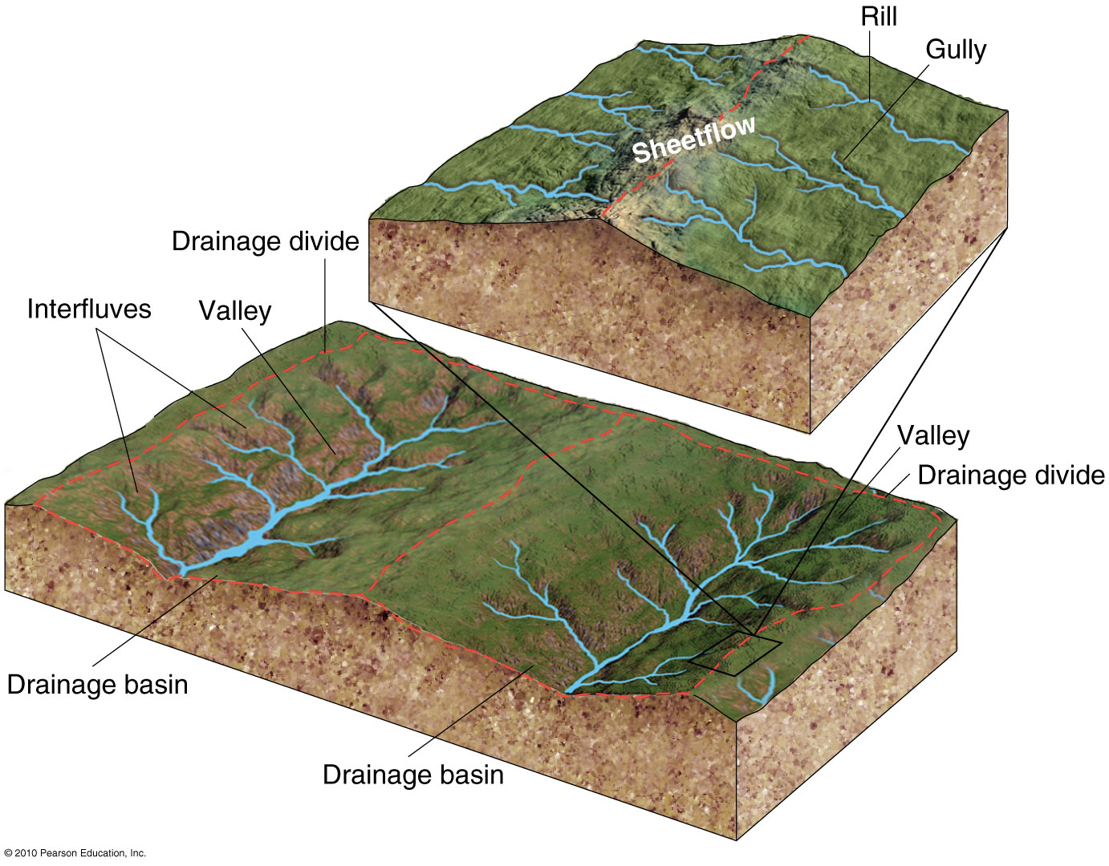
Drainage Basin
Figure 11.3
Christopherson, Elemental Geosystems, Sixth Edition
Copyright © 2010 Pearson Education, Inc.

Slide 10
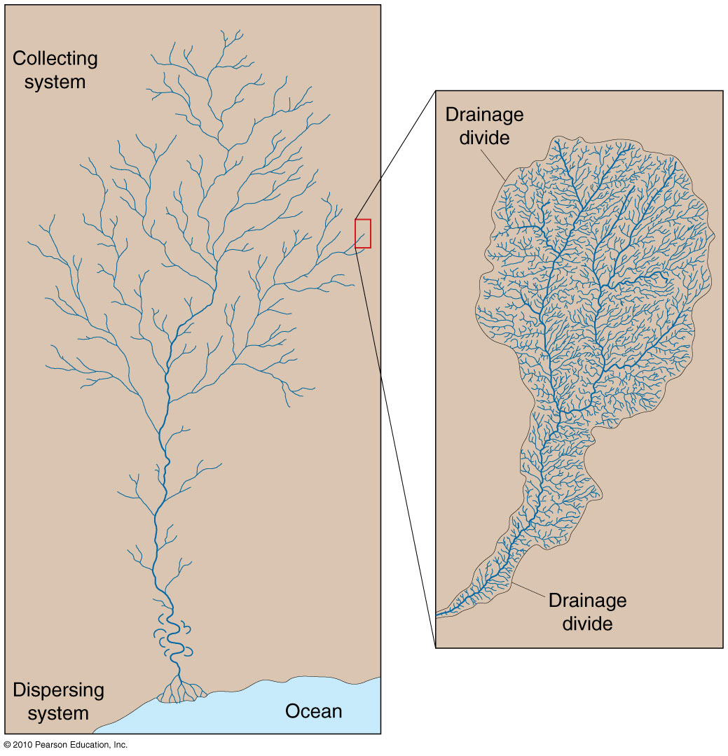
Drainage Basin System
Figure 11.4
Christopherson, Elemental Geosystems, Sixth Edition
Copyright © 2010 Pearson Education, Inc.

Slide 11
Fluvial Processes and Landscapes
Drainage divides and basins
Continental divides – extensive mountain & highland regions that separate drainage basins – sending flows to the Arctic, Pacific, Hudson Bay, Gulf of Mexico, Atlantic
Mississippi – Missouri-Ohio river system
International drainage basin – the Danube River
Crosses or forms the borders between 9 countries
Serves many economic functions
International struggle underway to save the river
Begins in eastern Germany and flows through Romania and deltaic ecosystems in the Black sea

Slide 12
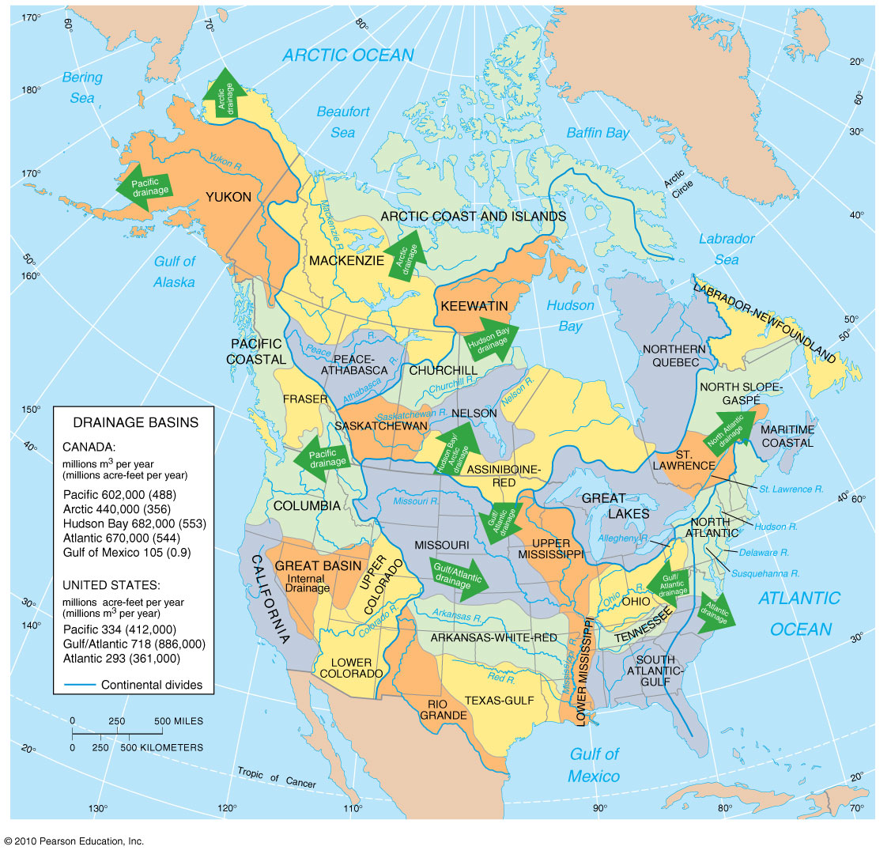
Drainage Basins Of the US & Canada
Figure 11.5
Christopherson, Elemental Geosystems, Sixth Edition
Copyright © 2010 Pearson Education, Inc.

Slide 13
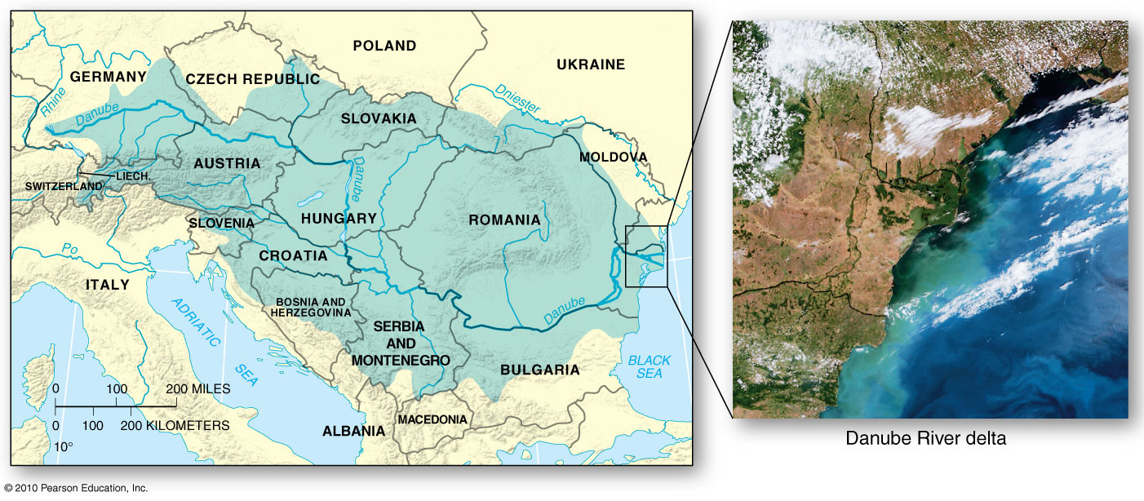
An International Drainage basin - The Danube River
Regarded as one of the Earth’s most polluted river basins
Figure 11.6

Slide 14
Fluvial Processes and Landscapes
Drainage basins as open systems
Inputs: precipitation, geology and tectonic activities
Outputs: water & sediment that leave through the mouth of the river
There is a constant struggle toward an equilibrium among interacting variables of discharge, transported sediment load, channel shape & channel slope
An example: The Delaware River Basin
Studied by the USGS to assess potential impact of global warming on a river system as temp. & precipitation change over it’s drainage basin

Slide 15
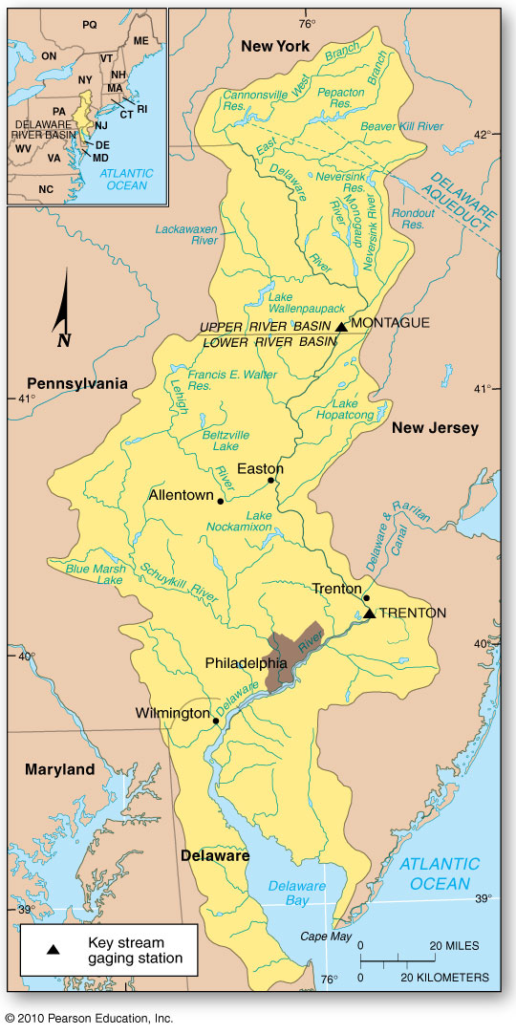
The Delaware River Basin
Figure 11.7
Christopherson, Elemental Geosystems, Sixth Edition
Copyright © 2010 Pearson Education, Inc.

Slide 16
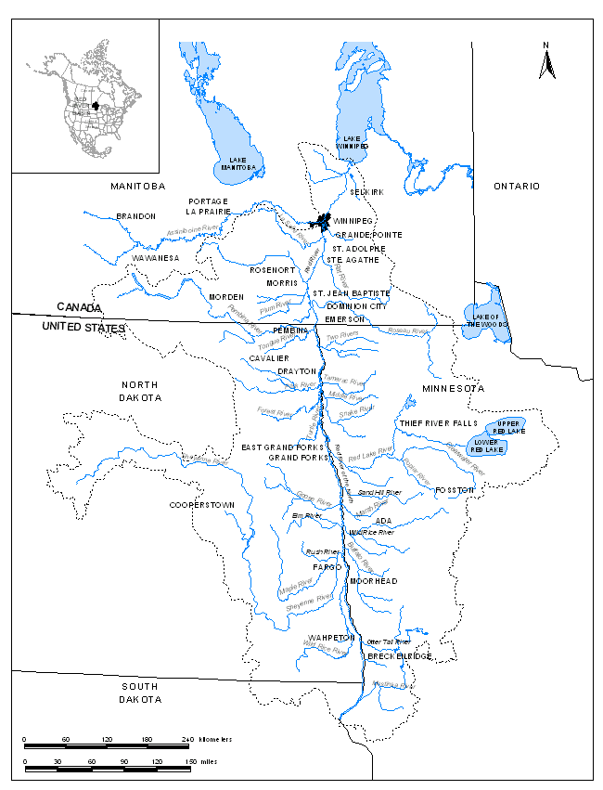
The Red River, or Red River of the North as it is known in the United States, flows north from its headwaters in Minnesota, across the Canada-United States international boundary, to its outlet at Lake Winnipeg in Manitoba.
Recent Flood Events:
1950
1997
2009
2010
2011

Slide 17
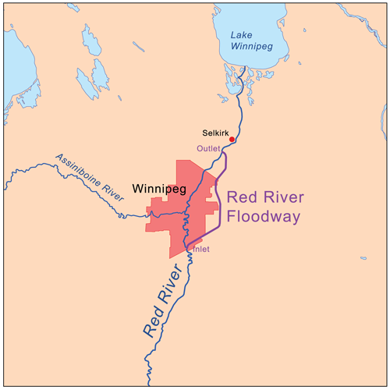
Melting snow and river ice, as well as runoff from its tributaries, often create ice dams, which cause the river to overflow. The valley is essentially flat, leading to overland flooding, with no high ground on which to take refuge.
The Red River Floodway is an artificial flood control waterway in Manitoba. It’s a 47 km long channel which, during flood periods, takes part of the Red River's flow around the city of Winnipeg, to the east and discharges it back into the Red River

Slide 18
Fluvial Processes and Landscapes
Drainage Density and Patterns
Drainage pattern – an arrangement of channels that is determined by:
slope
different rock resistance (rock structure)
climactic and hydrologic variability
relief of the land
structural controls imposed by landscape

Slide 19
Fluvial Processes and Landscapes
7 most common drainage patterns;
Dendritic (treelike)
Trellis characteristic of folded topography (capture)
Radial drainage – streams flow off a central peak or dome
Parallel drainage – associated with steep slopes
Rectangular pattern – formed by faulted and jointed landscape (right angle turns)
Annular patterns – associated with structural domes; concentric patterns of rock strata
Deranged pattern – glaciated regions of Canada, northern Europe

Slide 20
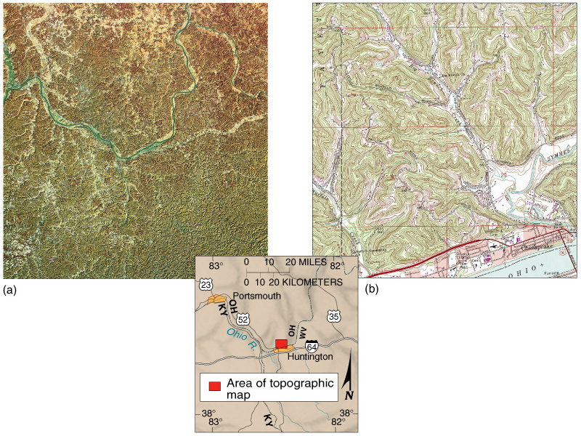
Highly Dissected Drainage
Figure 11.8
Christopherson, Elemental Geosystems, Sixth Edition
Copyright © 2010 Pearson Education, Inc.

Slide 21
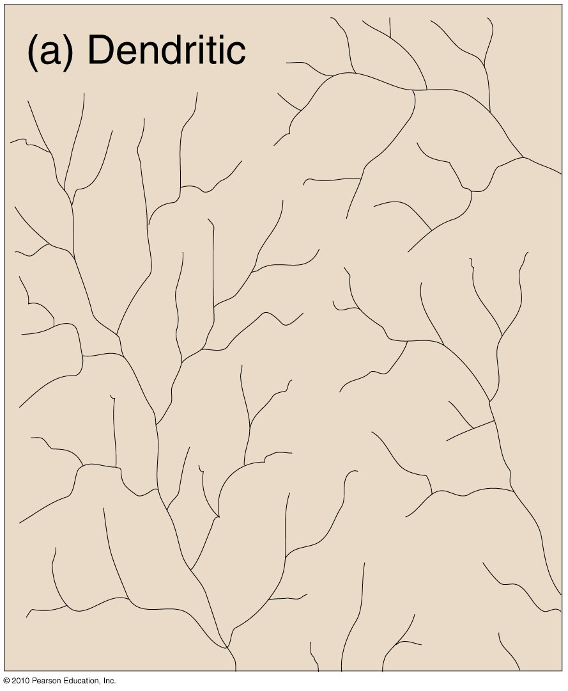
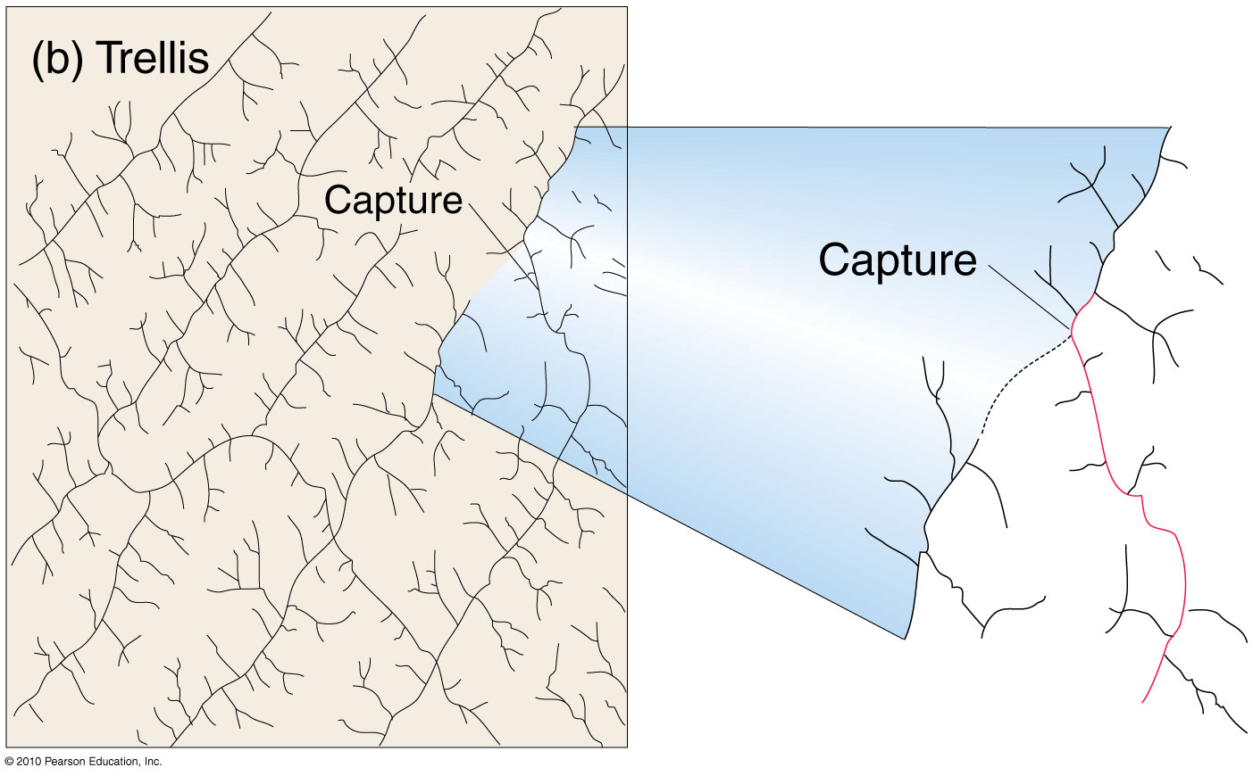
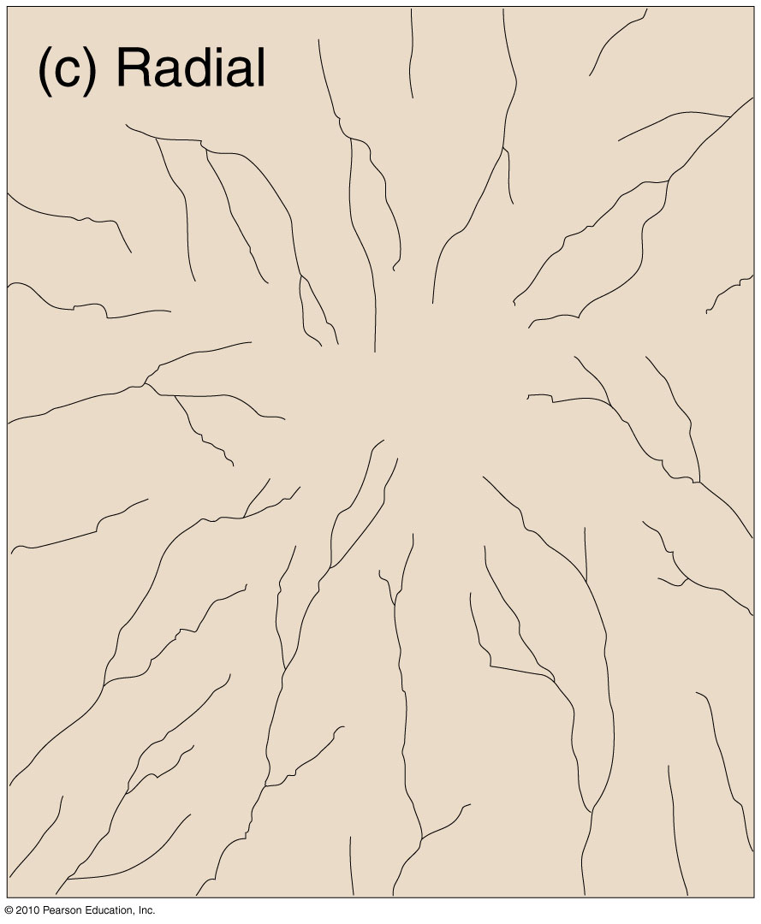
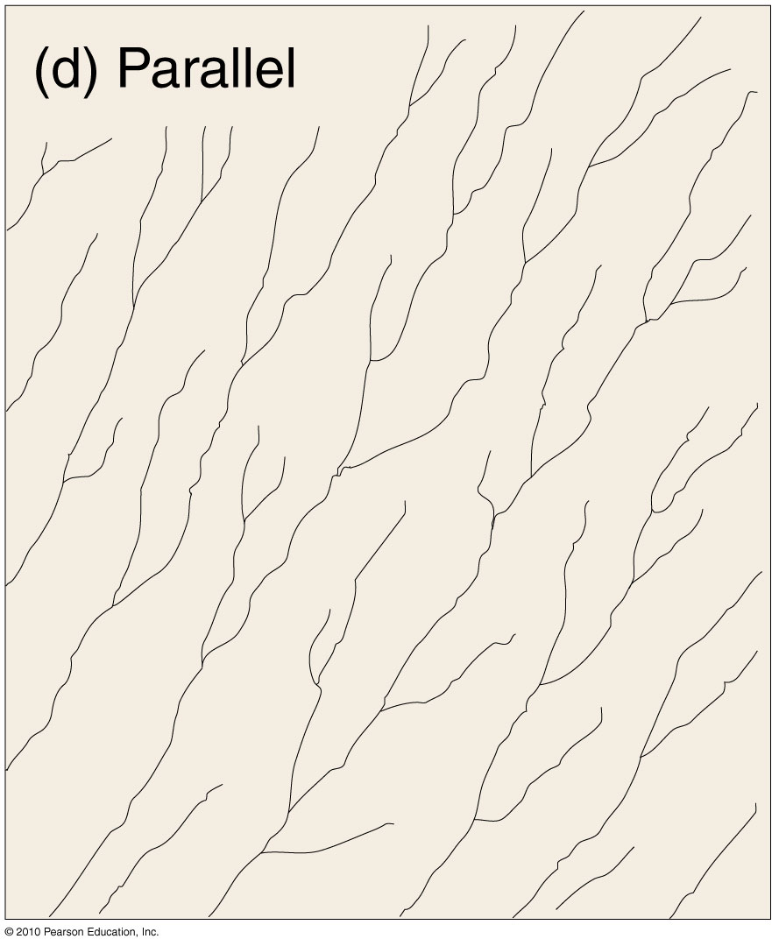
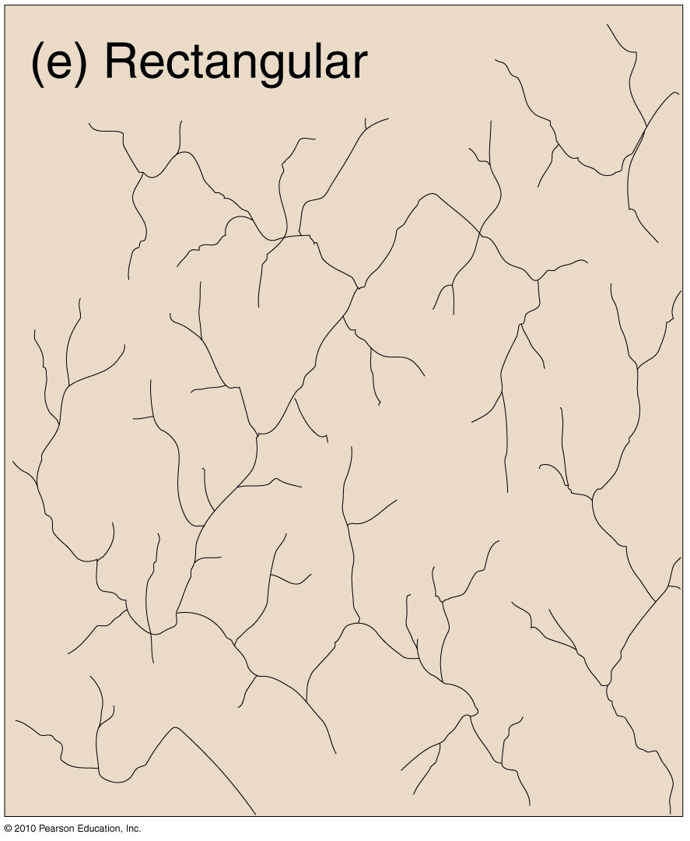
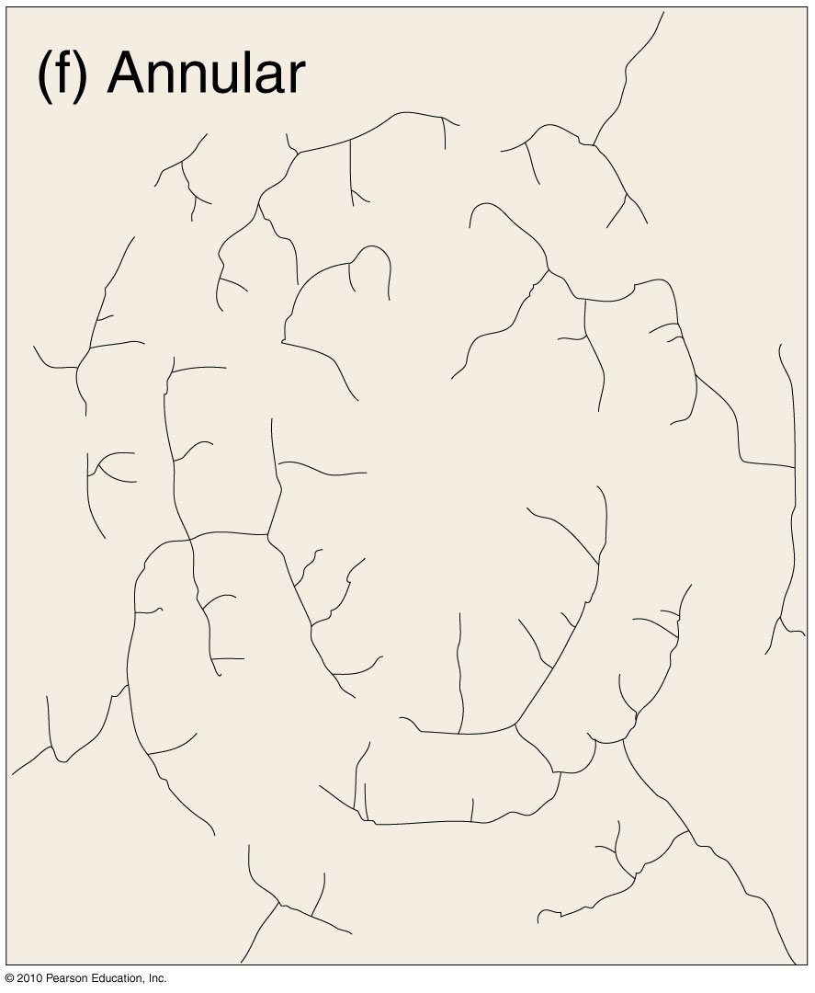
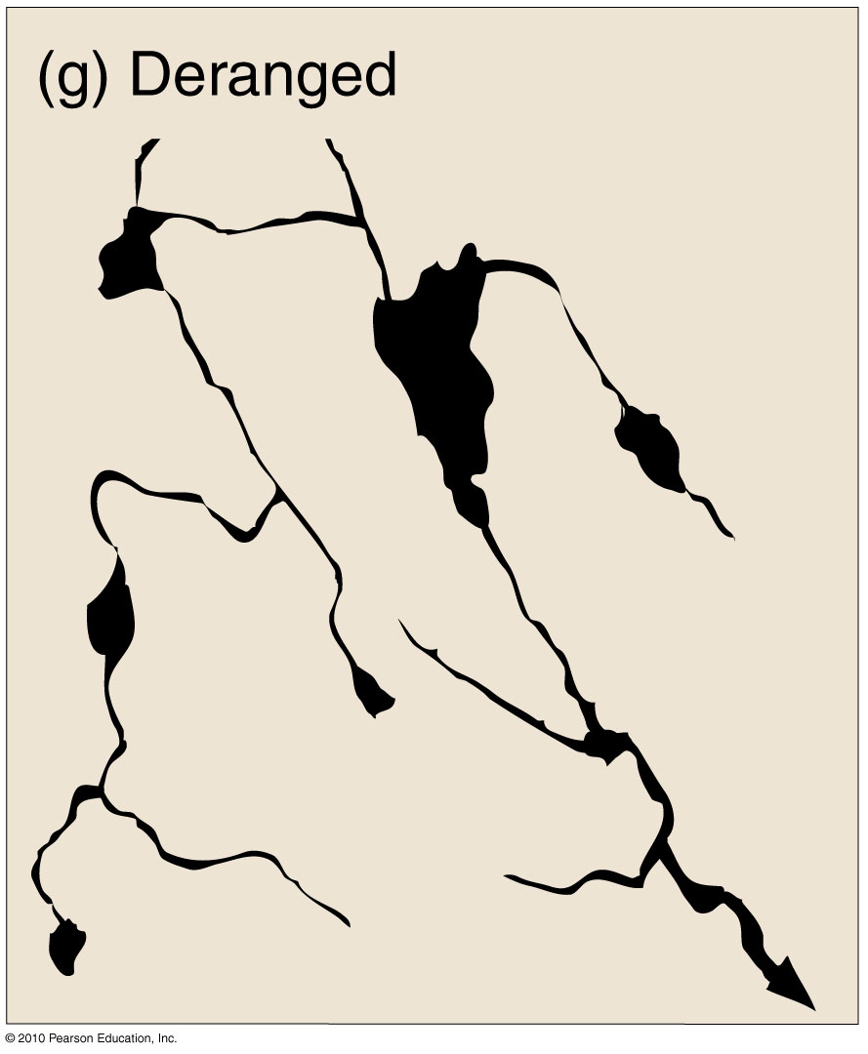
Drainage Patterns
Figure 11.9
Christopherson, Elemental Geosystems, Sixth Edition
Copyright © 2010 Pearson Education, Inc.

Slide 22
Streamflow Characteristics
Water above base level – potential energy
Water flows downstream due to gravity – kinetic energy
Conversion from potential to kinetic energy is a function of the steepness of the stream channel
Stream channels
Vary in width & depth
Streams
Vary in velocity and in the sediment load they carry
These factors increase with increasing discharge (stream’s volume of flow per unit time)
Q = wdv

Slide 23
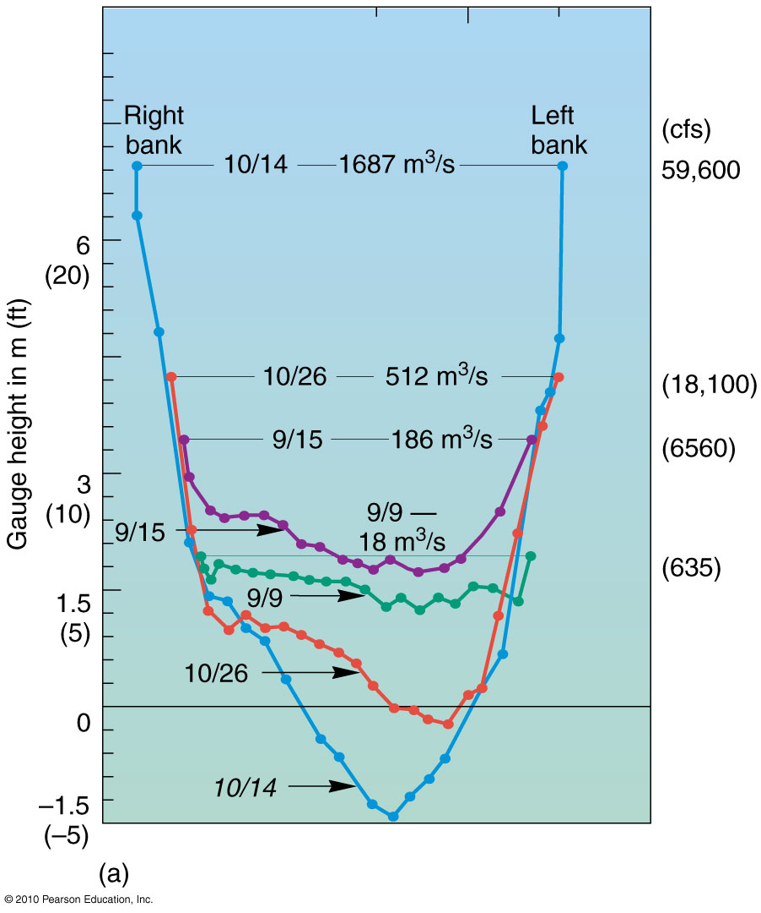
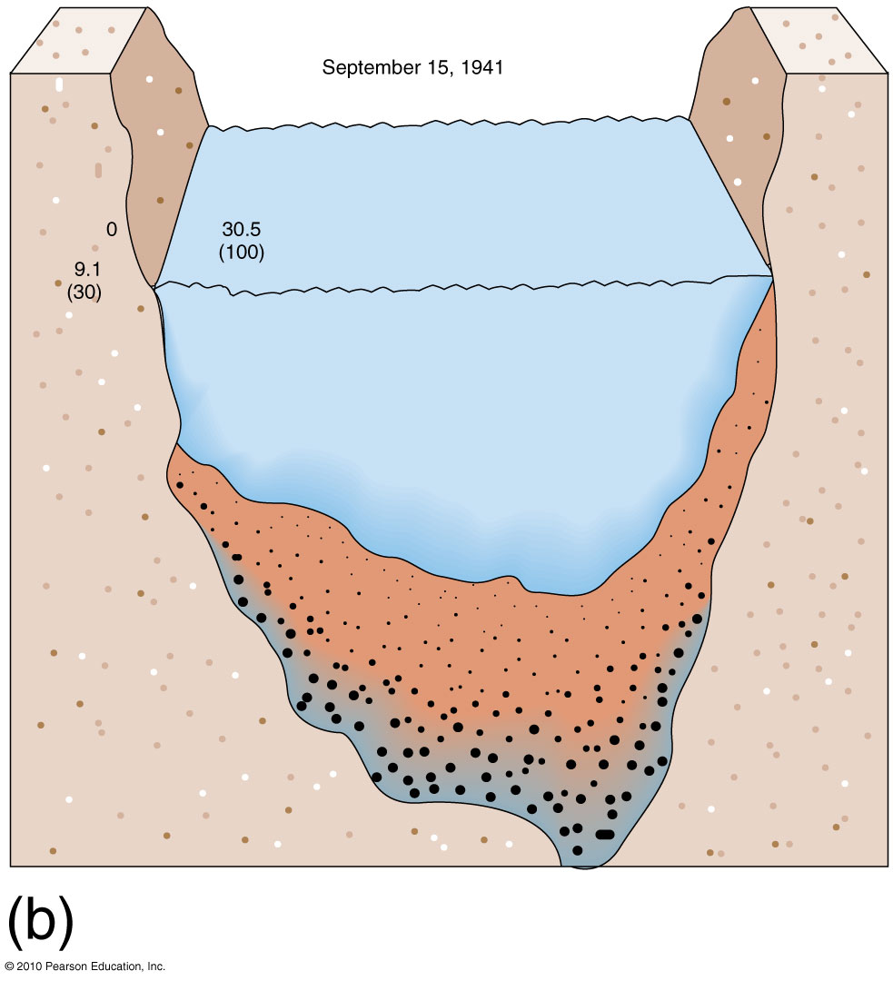
Stream Channel Flood Response
September 15, 1941
San Juan River near Bluff, Utah
Figure 11.10
Christopherson, Elemental Geosystems, Sixth Edition
Copyright © 2010 Pearson Education, Inc.

Slide 24
Streamflow Characteristics
Exotic Streams
a stream whose discharge decreases with distance – flowing from humid region to arid region (high evapotranspiration and withdrawal of water for agriculture) e.g. the Nile River & the Colorado River
Stream Erosion
Hydraulic action
abrasion

Slide 25
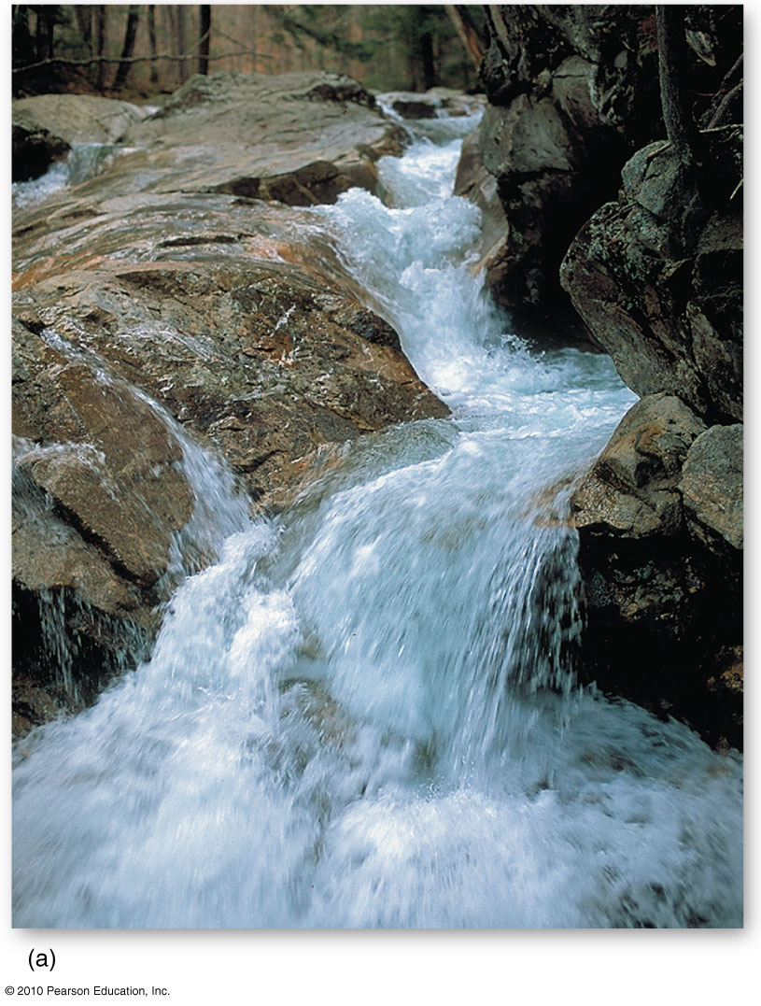
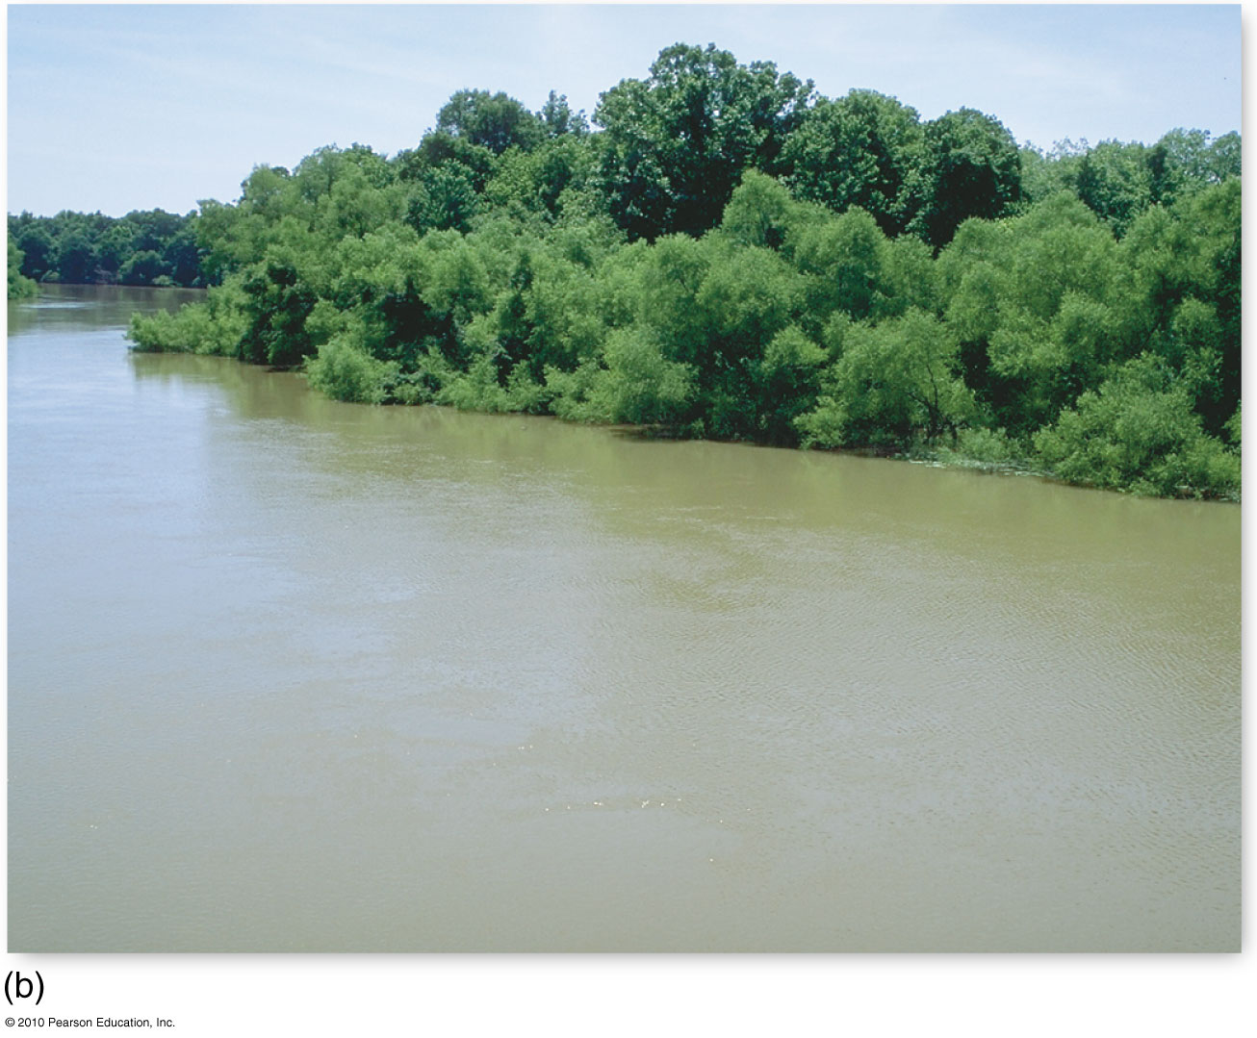
Stream Velocity and Discharge
Volume and velocity are important determinants of the amount of
energy expended in the erosion & transportation of sediment
Figure 11.11
Christopherson, Elemental Geosystems, Sixth Edition
Copyright © 2010 Pearson Education, Inc.

Slide 26
Streamflow Characteristics
Stream Transport
Competence; stream’s ability to move particles of specific size – function of stream’s velocity
Capacity; total possible load that a stream can support
Aggradation – load exceeds it’s capacity sediments accumulate ~ development of a braided stream pattern
4 processes transport eroded material
Solution; the dissolved load
Suspended load; fine-grained, clastic particles
Bed load; coarser materials dragged along the bed of the stream by traction, or rolled and bounced around by saltation

Slide 27
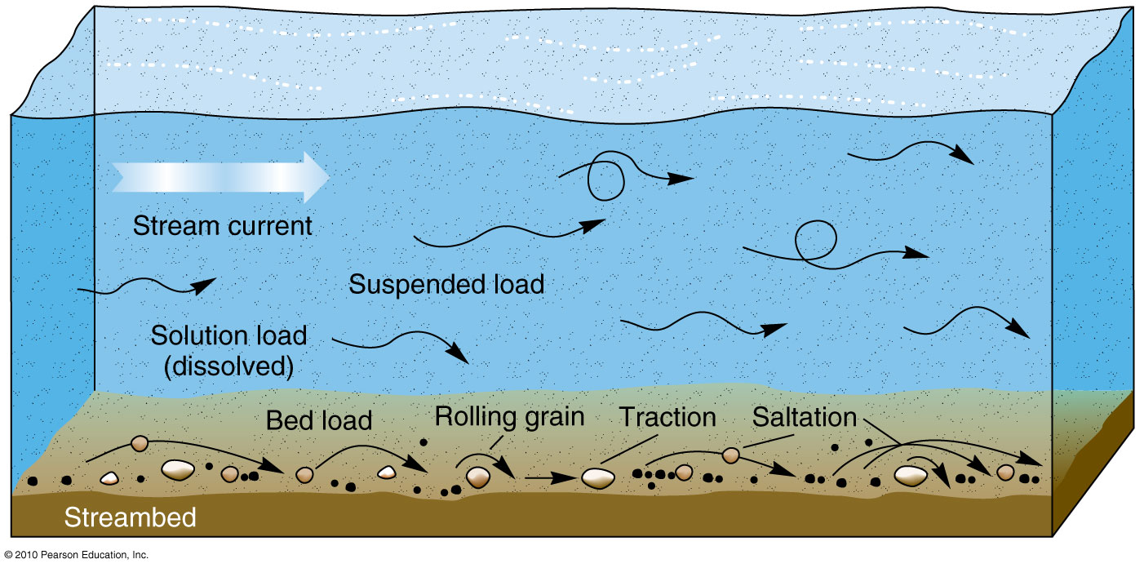
Fluvial Transport
Figure 11.12

Slide 28
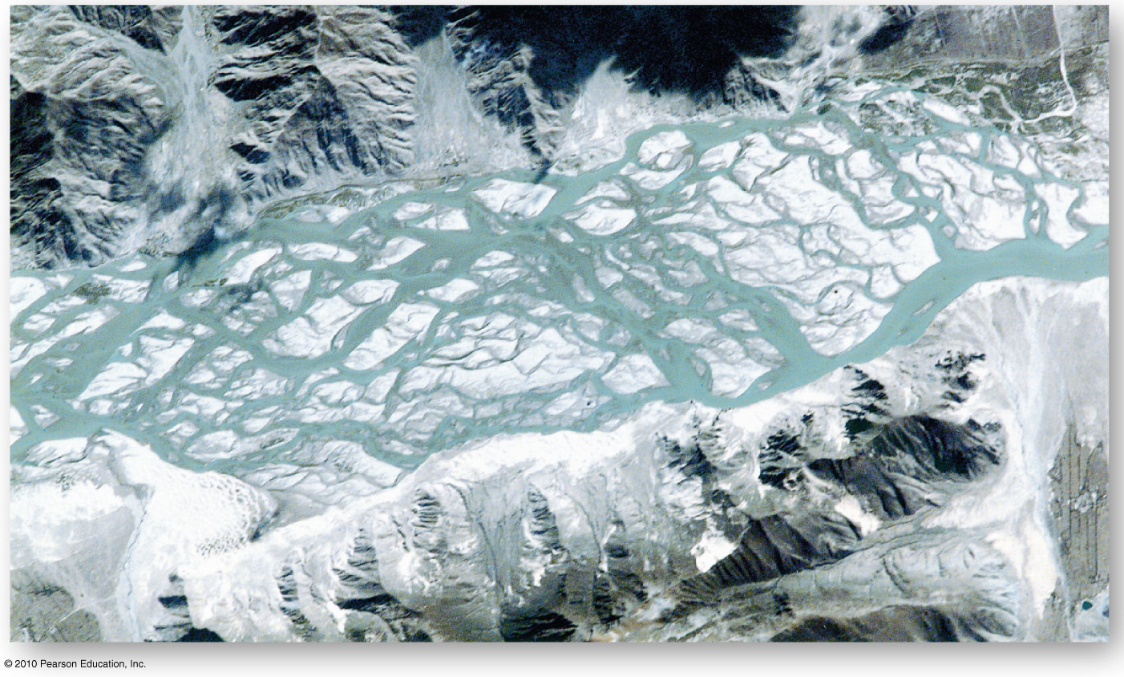
Braided Stream
Figure 11.13
Christopherson, Elemental Geosystems, Sixth Edition
Copyright © 2010 Pearson Education, Inc.

Slide 29
Streamflow Characteristics
Flow and Channel Characteristics
Meandering streams
Undercut bank
Point bar deposit
Neck, cutoff – oxbow lake
Stream Gradient
Gradient –decline in elevation from its headwaters to its mouth longitudinal profile of a stream
Graded stream – when stream load and the landscape through which it flows become mutually adjusted – dynamic equilibrium
Rejuvenation due to tectonic uplift; entrenched meanders
Nickpoints: abrupt change in gradient e.g. waterfall or rapids
Niagara Falls

Slide 30
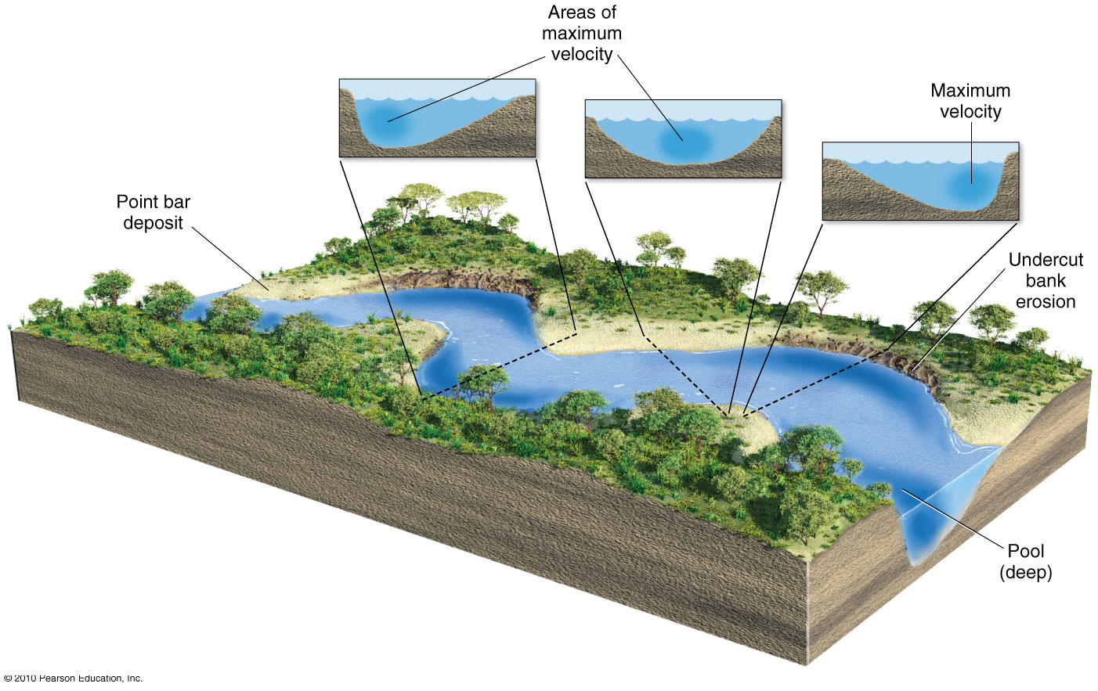
Meandering Stream Profile
Figure 11.14
Christopherson, Elemental Geosystems, Sixth Edition
Copyright © 2010 Pearson Education, Inc.

Slide 31
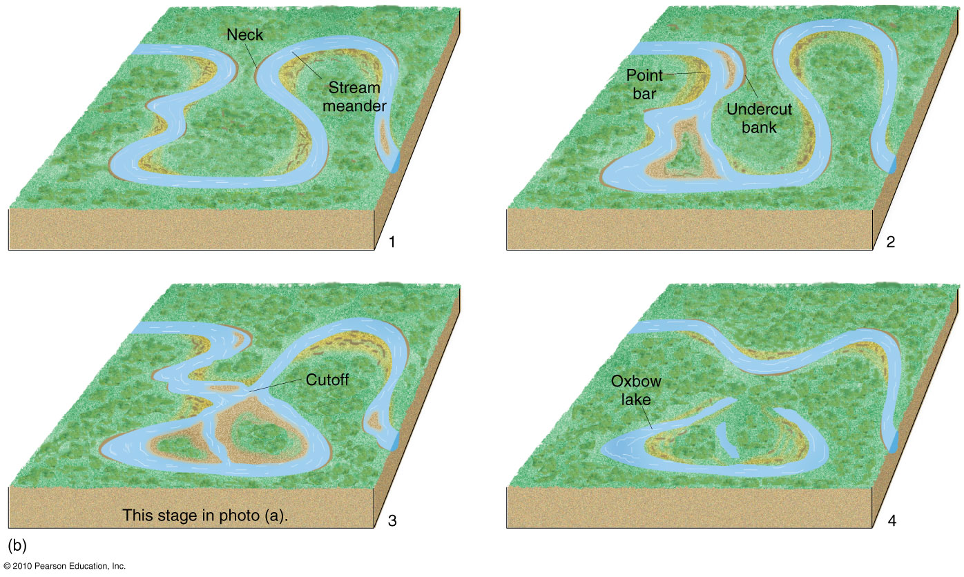
Meandering Stream Development
Figure 11.15

Slide 32
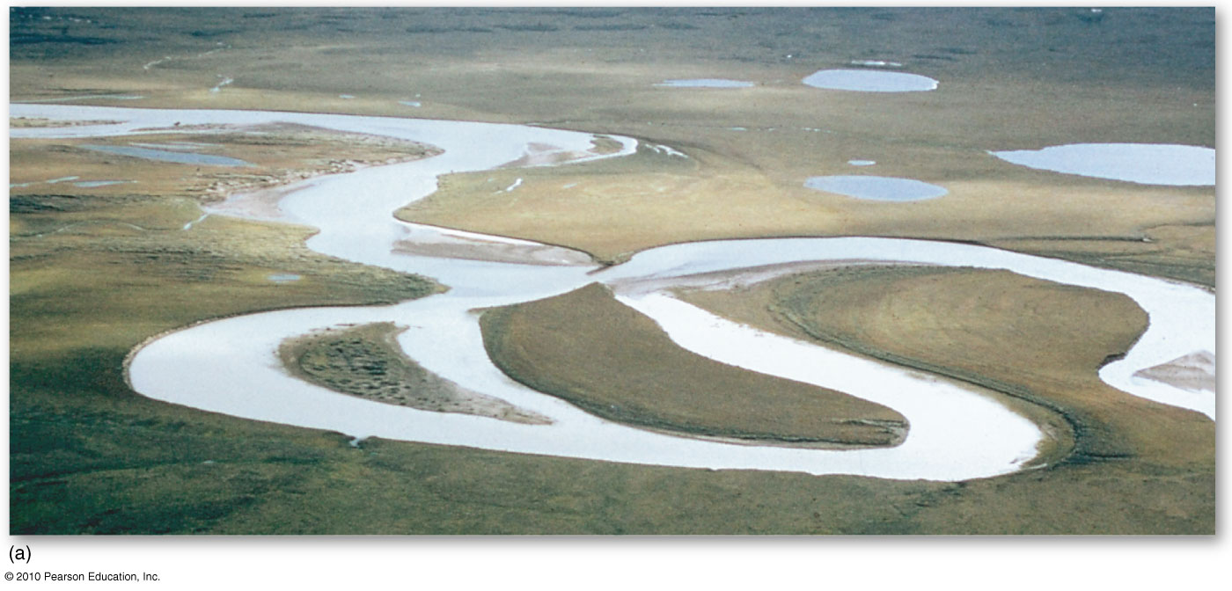
Itkillik River, Alaska
Figure 11.15

Slide 33
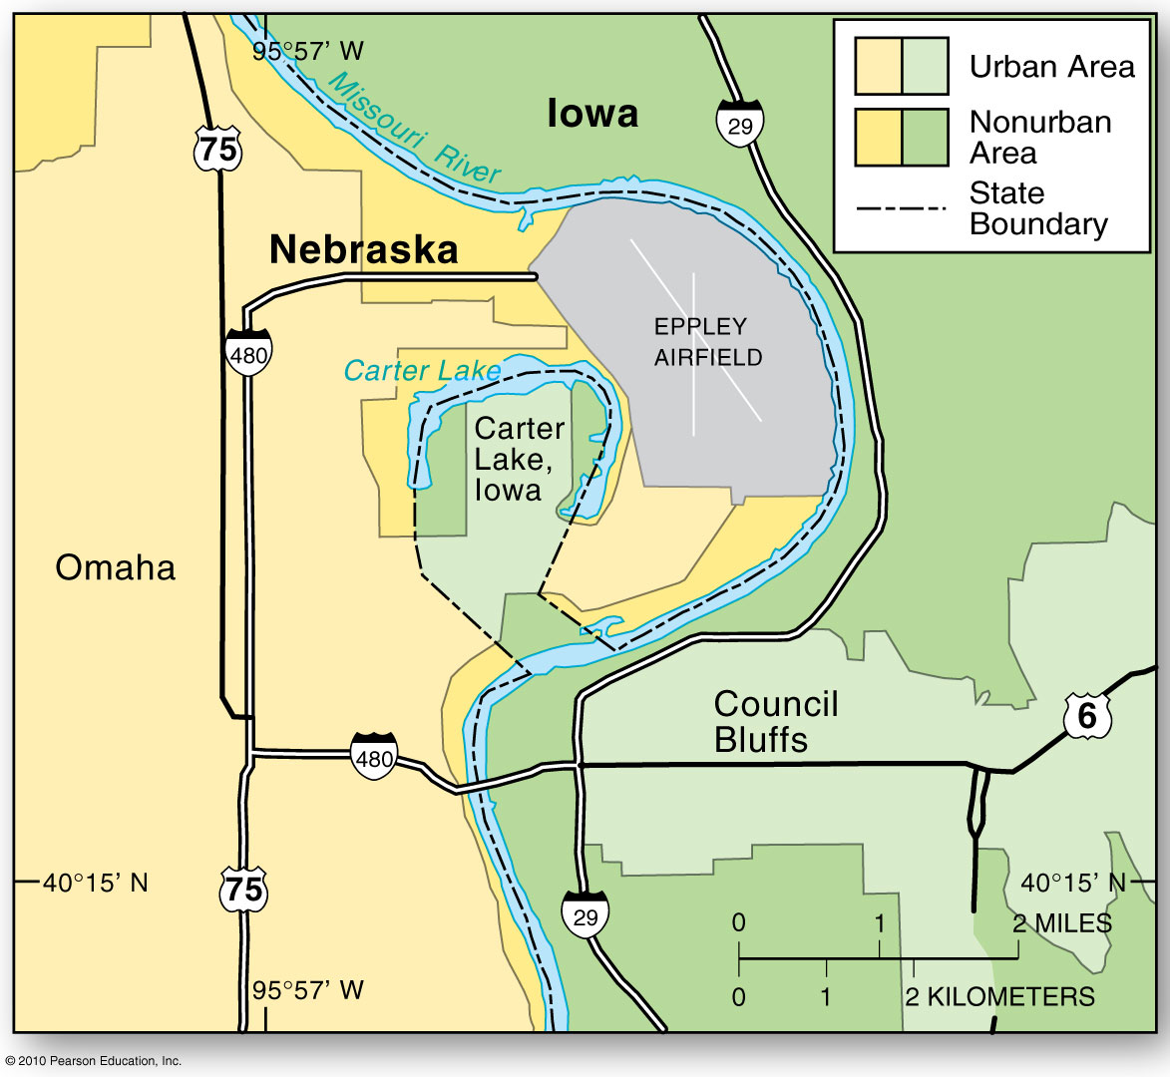
Rivers as Political Boundaries
Figure 11.16
Christopherson, Elemental Geosystems, Sixth Edition
Copyright © 2010 Pearson Education, Inc.

Slide 34
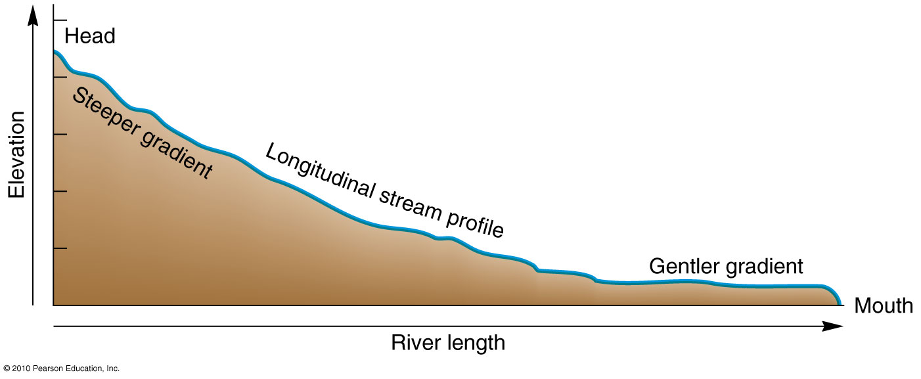
Longitudinal Profile of a Stream showing its gradient
Middle & lower portions appear graded
or in dynamic equilibrium
Figure 11.17

Slide 35
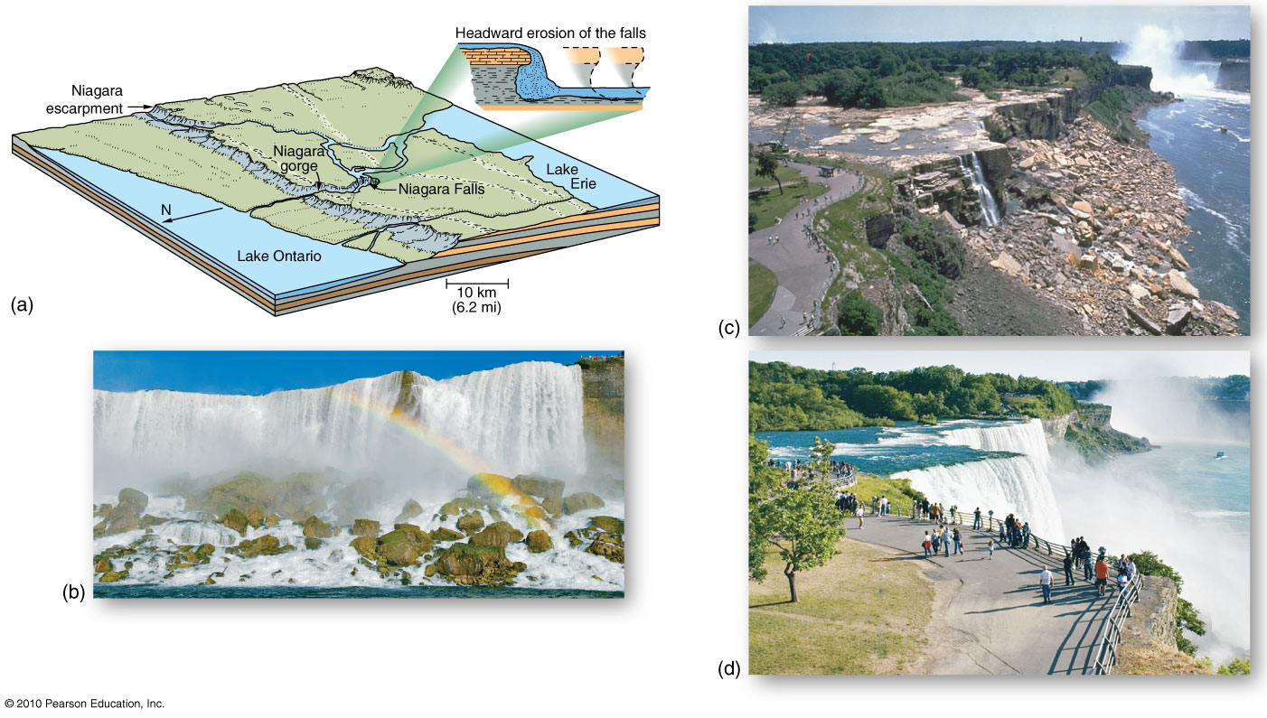
Retreat of Niagara Falls
Figure 11.20

Slide 36
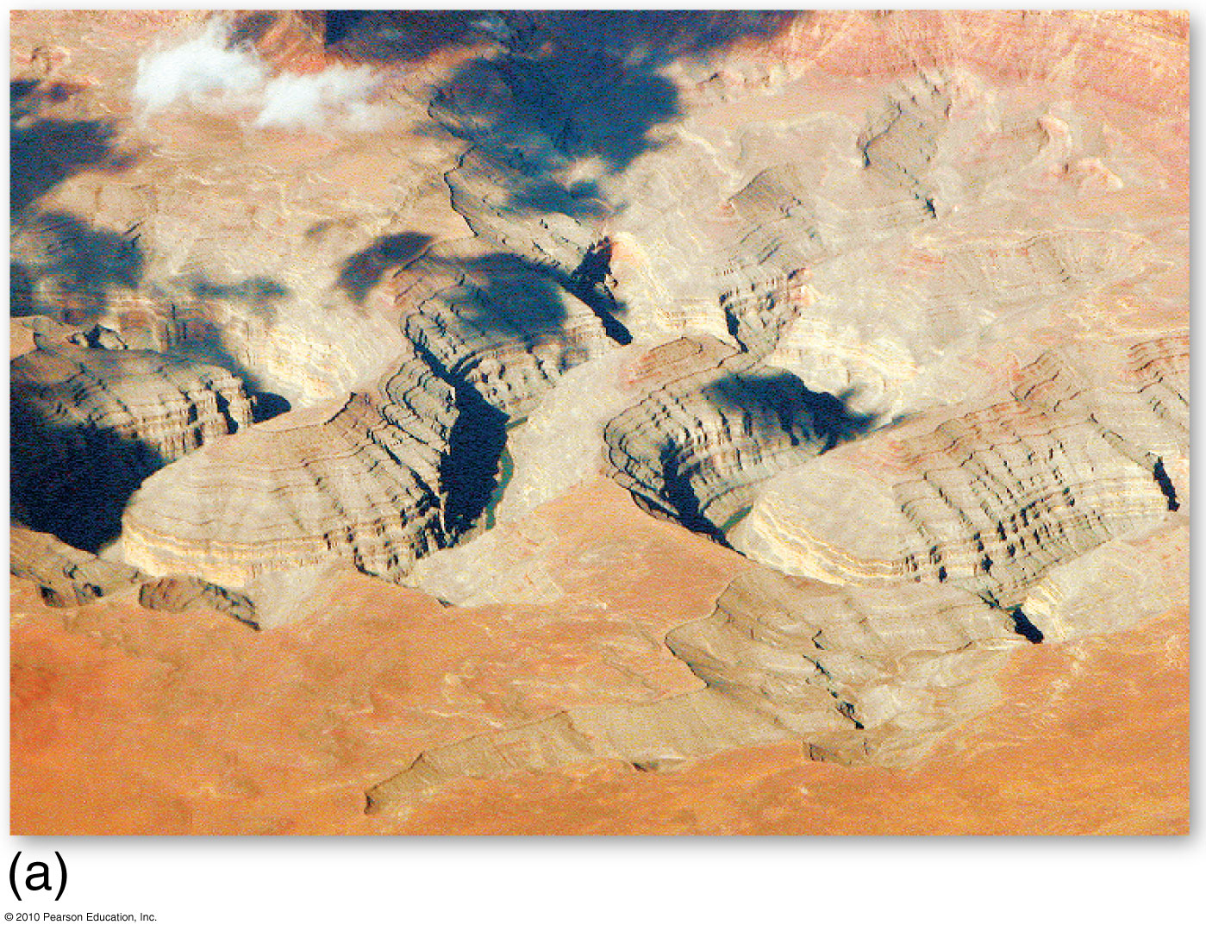
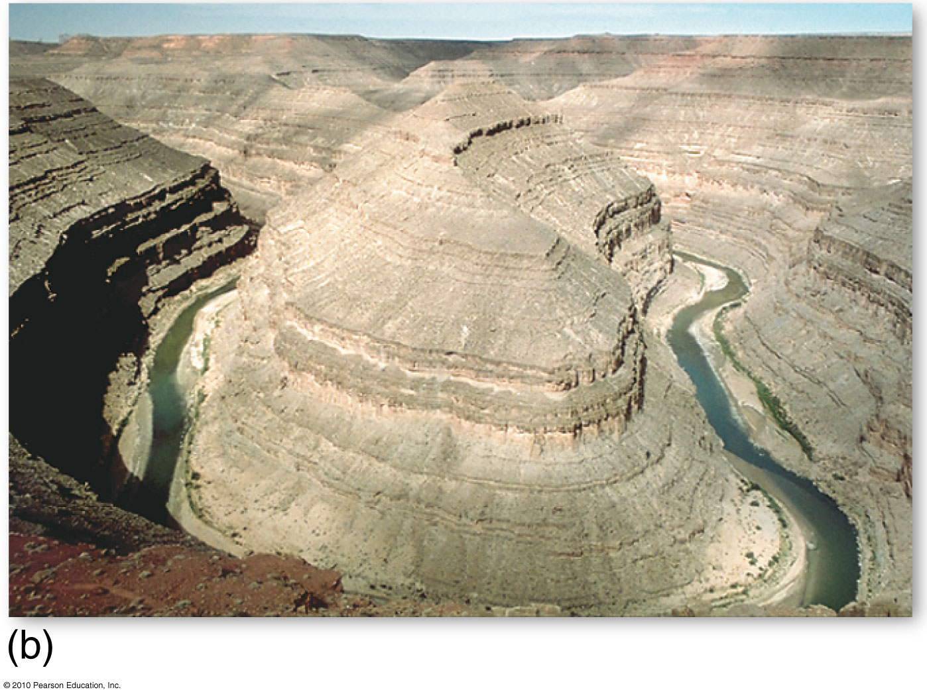
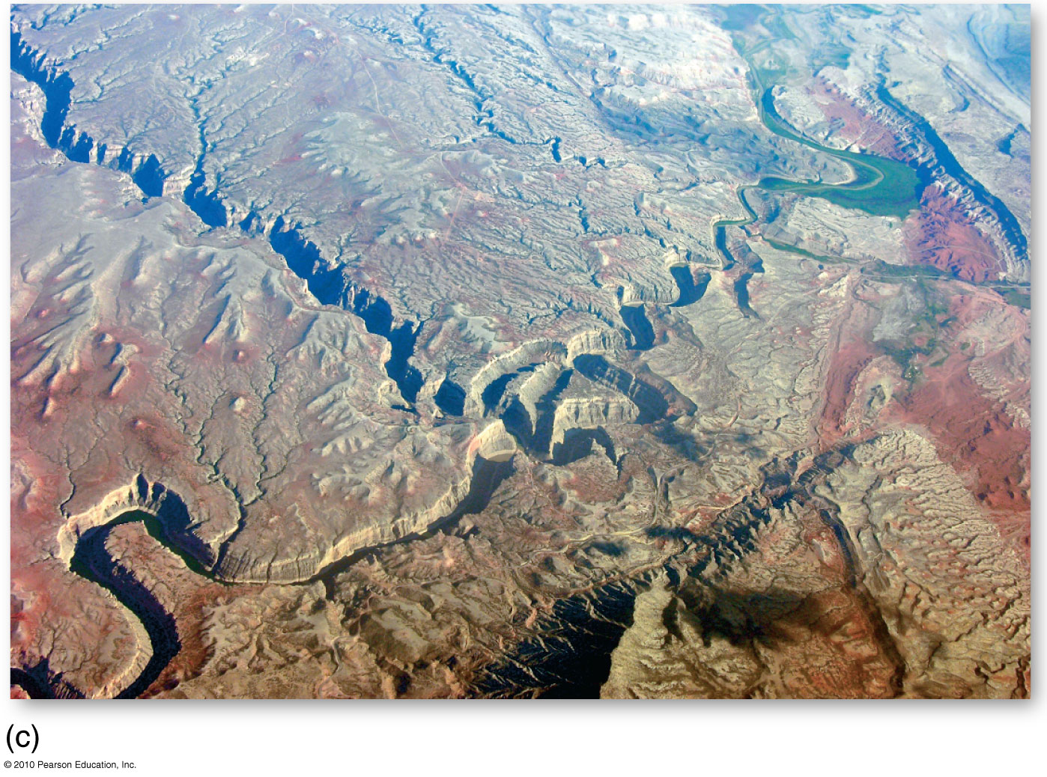
Entrenched Meanders
Figure 11.18
Christopherson, Elemental Geosystems, Sixth Edition
Copyright © 2010 Pearson Education, Inc.

Slide 37
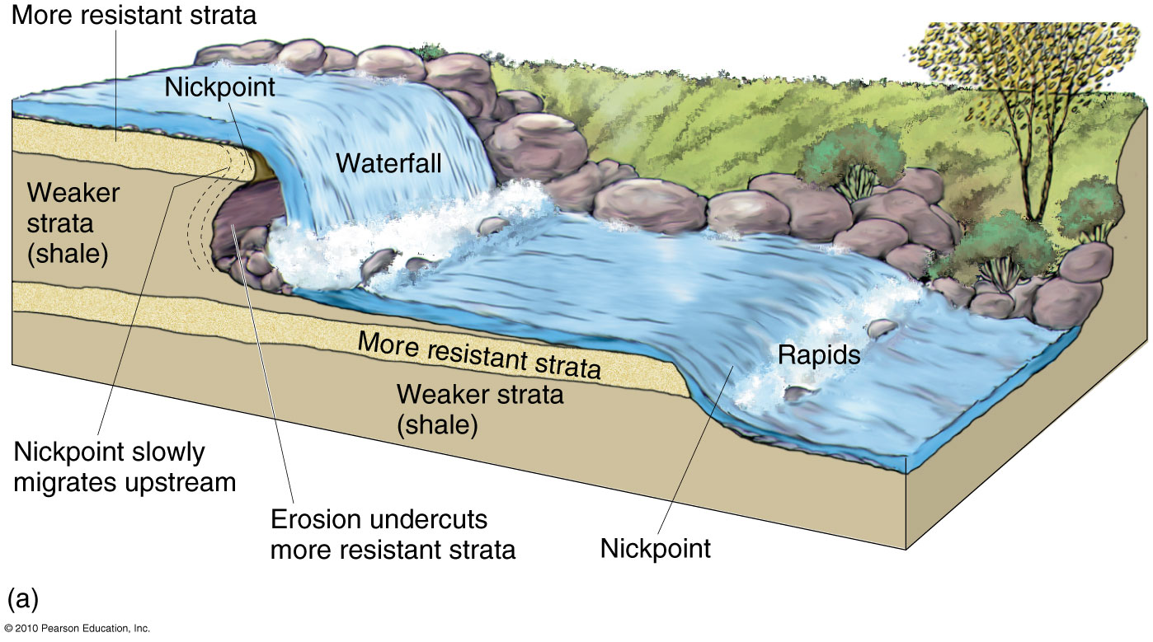
Nickpoint
Figure 11.19

Slide 38
Streamflow Characteristics
Stream Deposition
Floodplains
Natural levees
Backswamp
Stream terraces
Alluvial terraces
River deltas

Slide 39
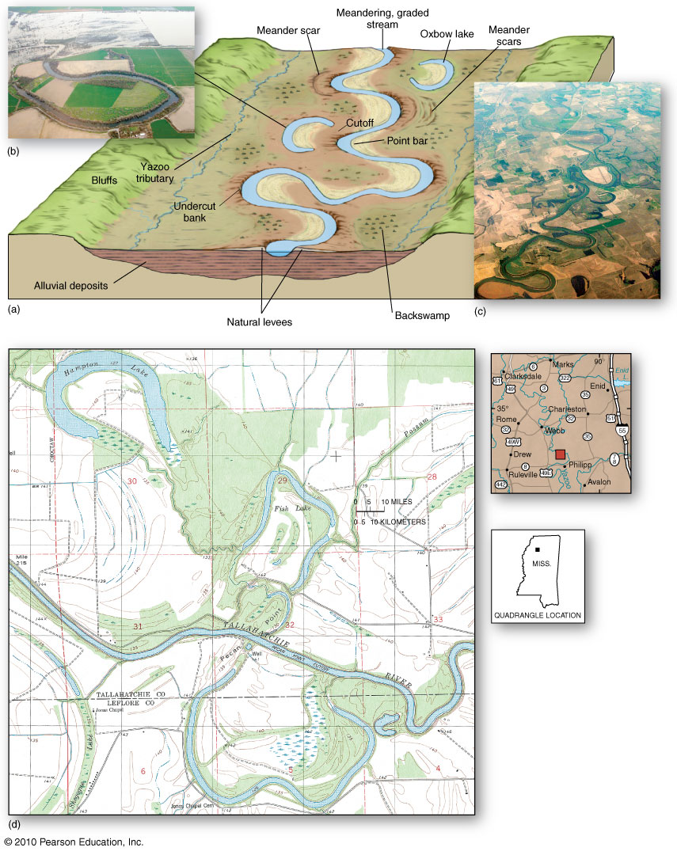
Floodplain
Features
Figure 11.21

Slide 40
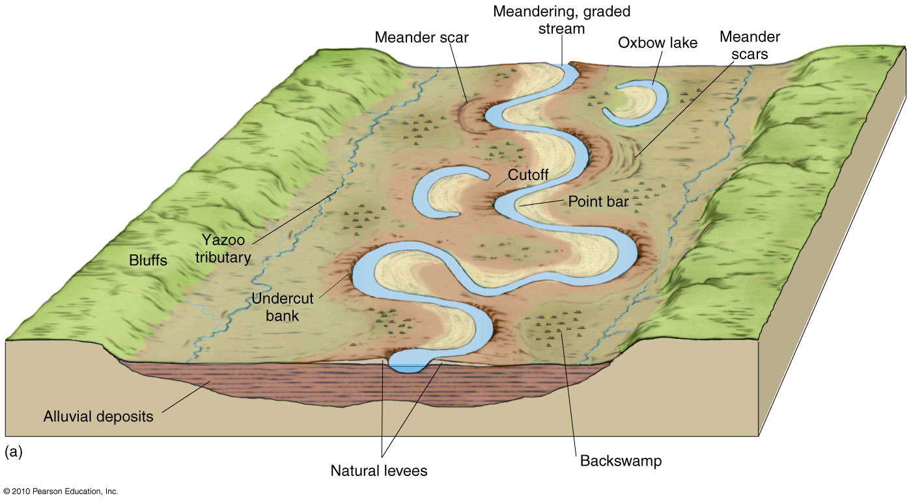
Typical Floodplain Landscape and related Landscape Features

Slide 41
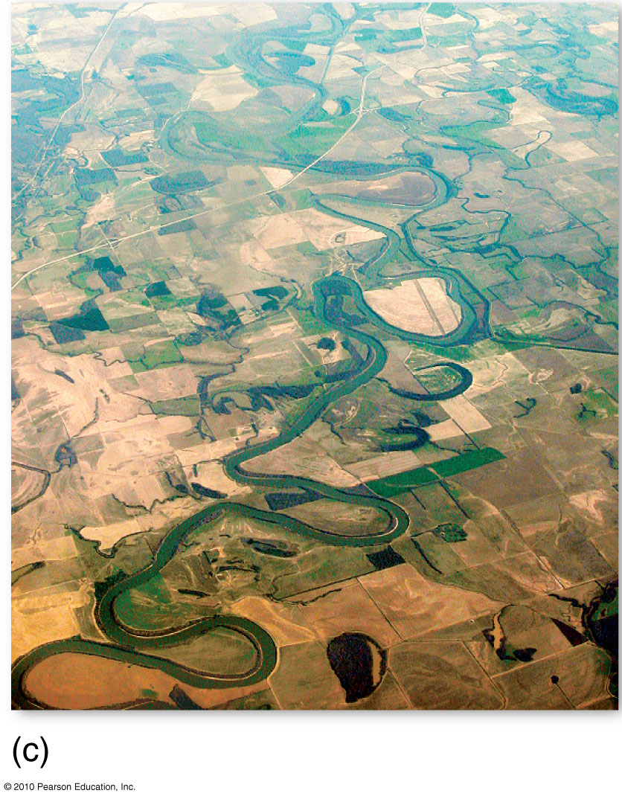
Levees, oxbow lakes and farmland in a floodplain

Slide 42
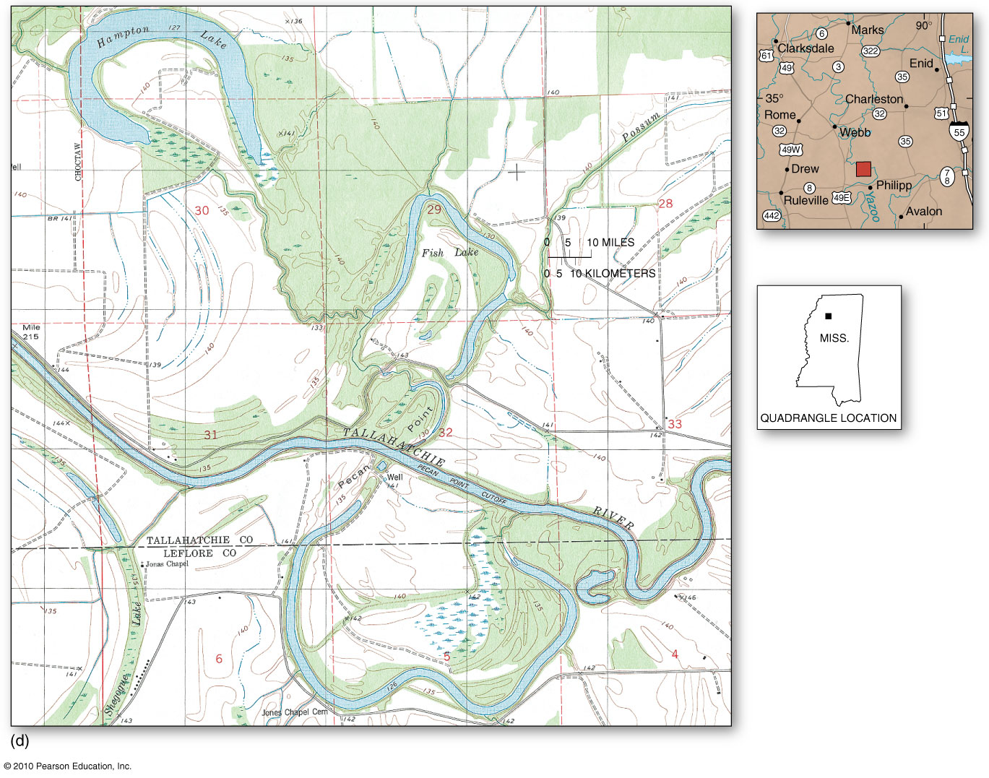
A portion of the Philipp, Mississippi topographic map quadrangle

Slide 43
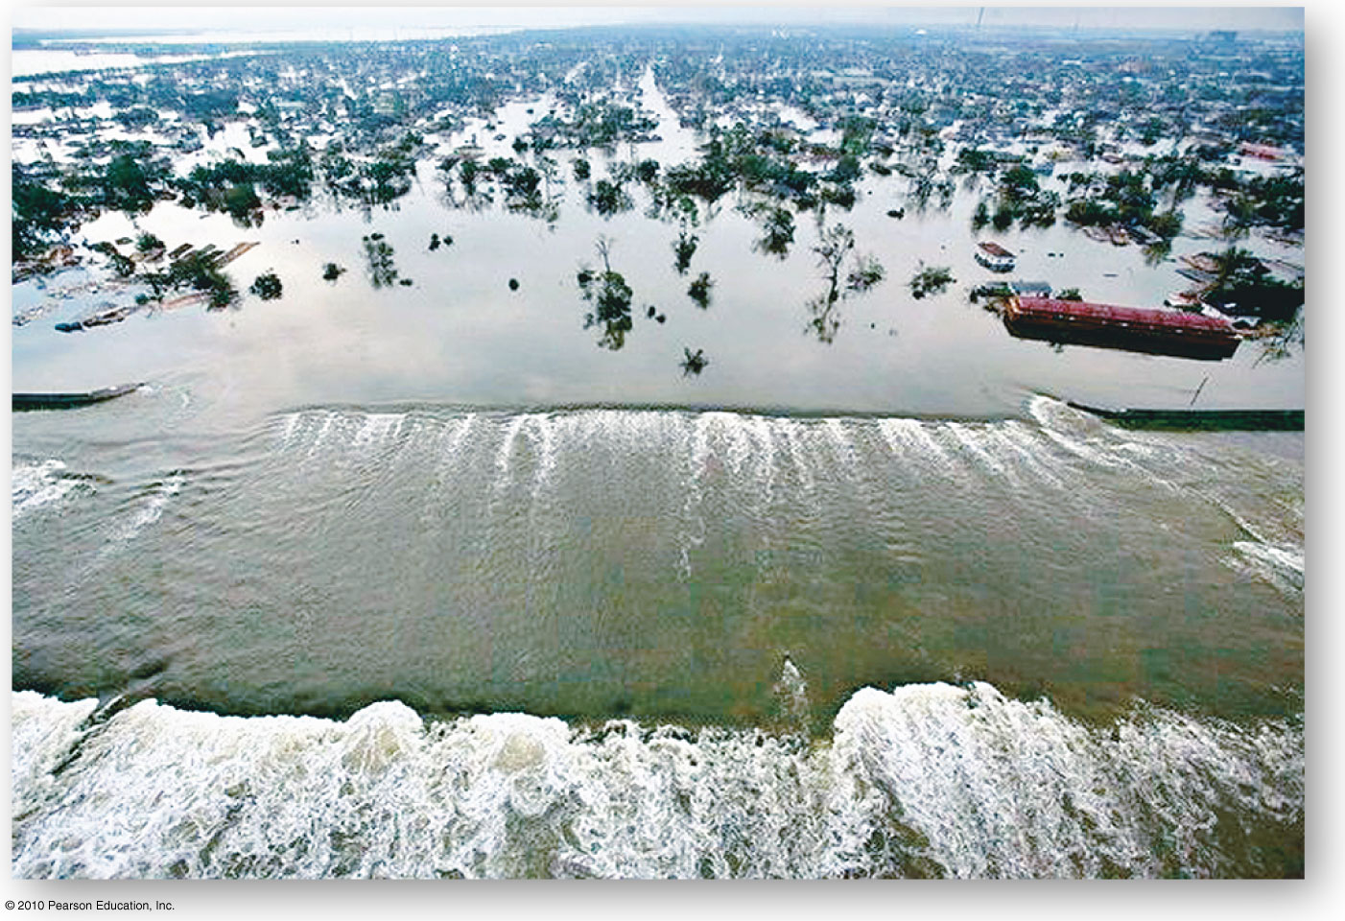
Levee Break, New Orleans
Figure 11.22
Christopherson, Elemental Geosystems, Sixth Edition
Copyright © 2010 Pearson Education, Inc.

Slide 44
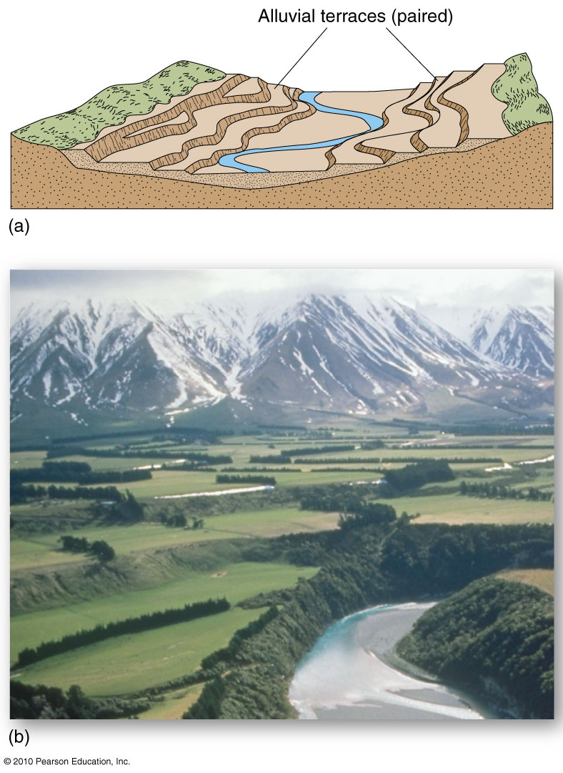
Alluvial Terraces
Figure 11.23
Christopherson, Elemental Geosystems, Sixth Edition
Copyright © 2010 Pearson Education, Inc.

Slide 45
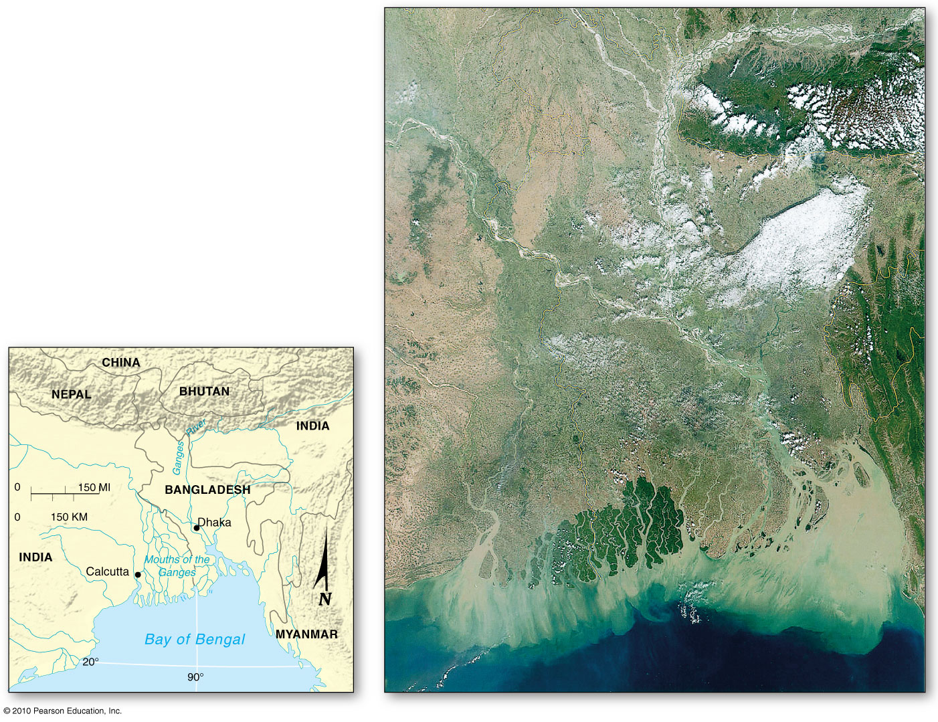
Ganges River Delta
Figure 11.24
Christopherson, Elemental Geosystems, Sixth Edition
Copyright © 2010 Pearson Education, Inc.

Slide 46
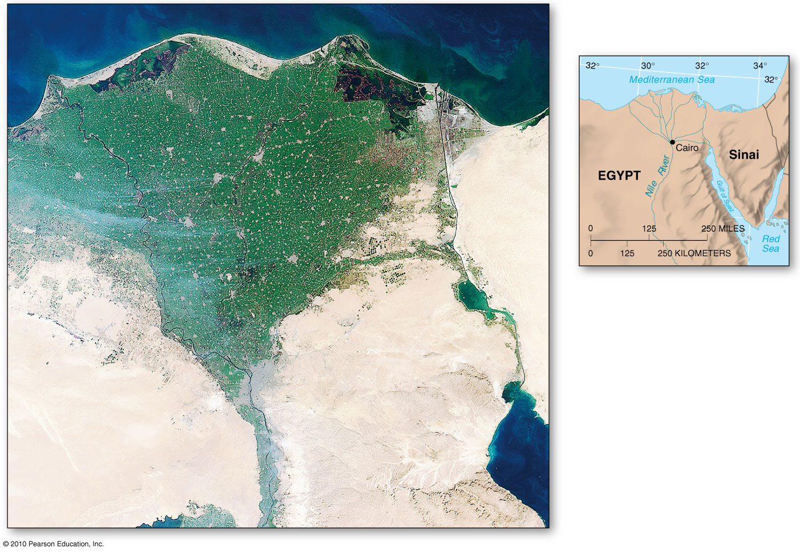
Nile River Delta
Figure 11.25
Christopherson, Elemental Geosystems, Sixth Edition
Copyright © 2010 Pearson Education, Inc.

Slide 47
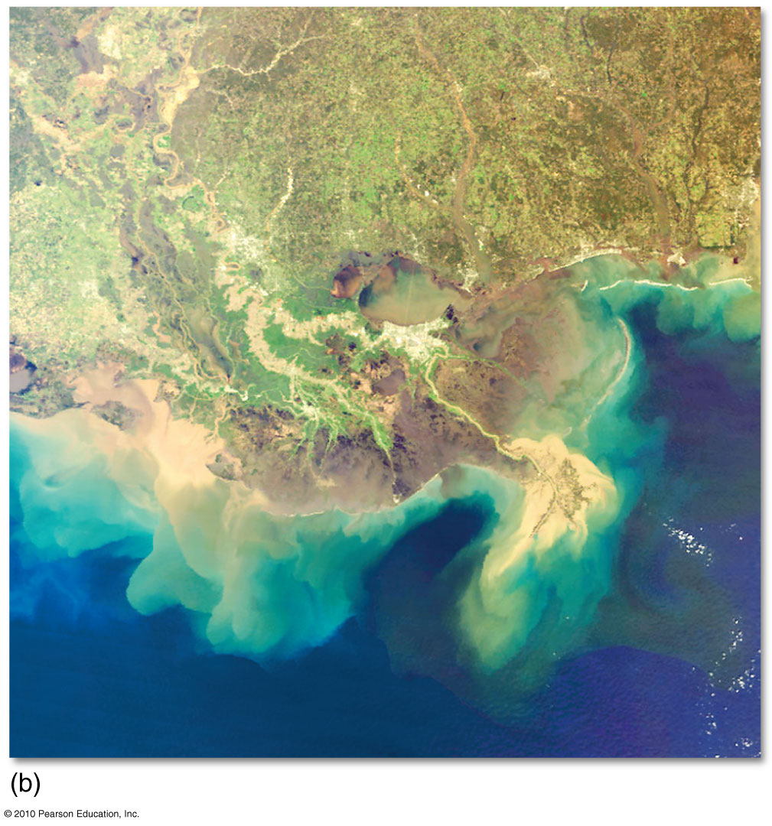
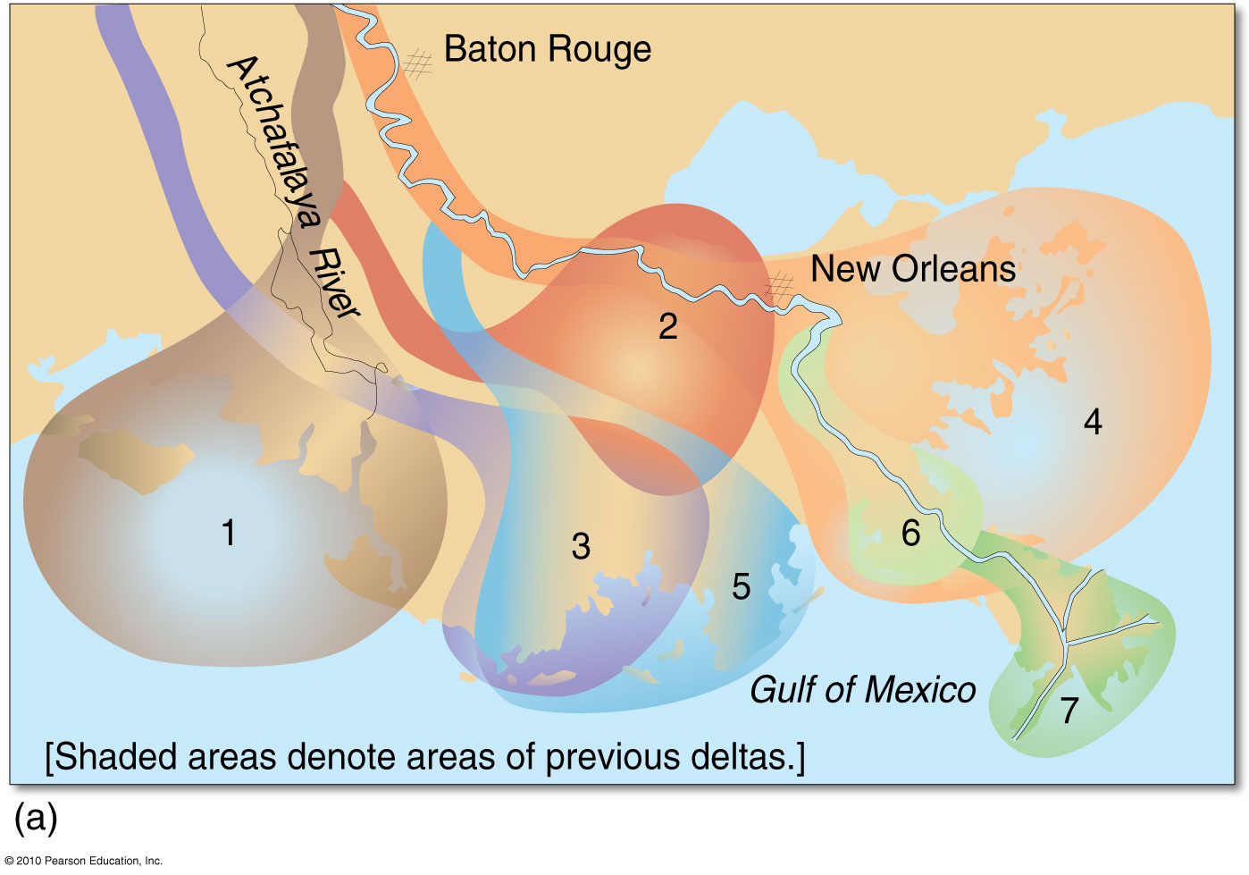
Mississippi River Delta
Figure 11.26

Slide 48
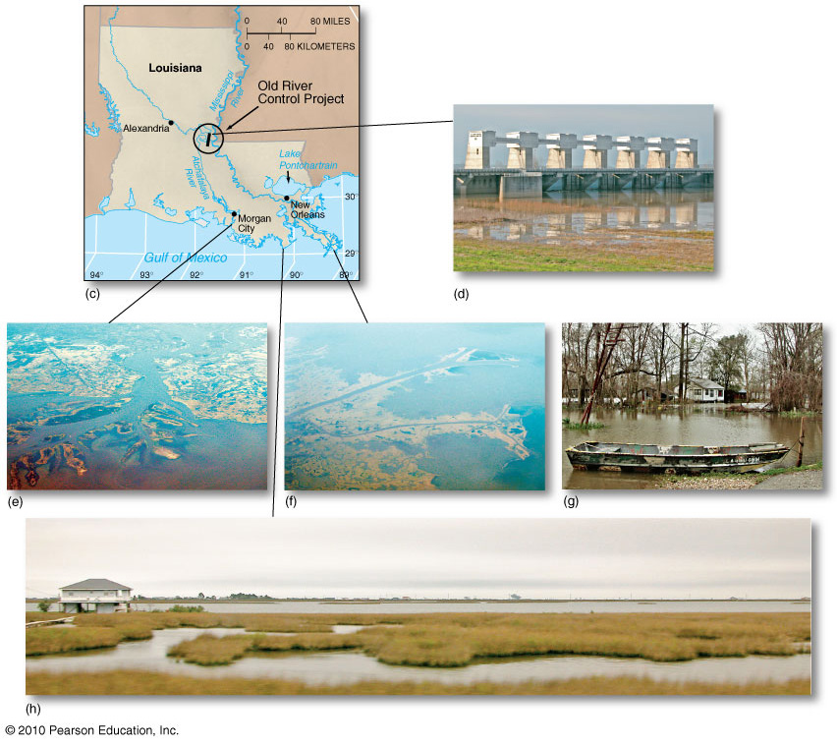
Mississippi River Delta
Figure 11.26
Christopherson, Elemental Geosystems, Sixth Edition
Copyright © 2010 Pearson Education, Inc.

Slide 49
Floods and River Management
Floods and Floodplains
Engineering Failures in New Orleans, 2005
Streamflow Measurement

Slide 50
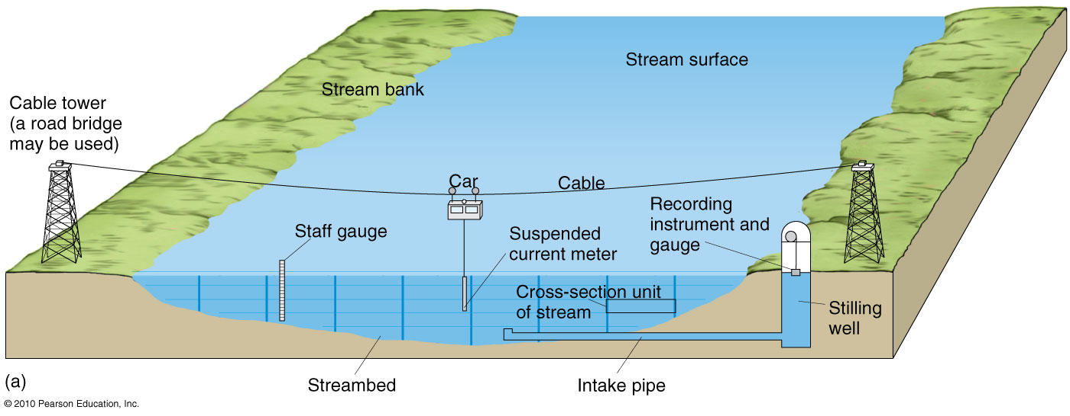
Streamflow Measurement
Figure 11.30

Slide 51
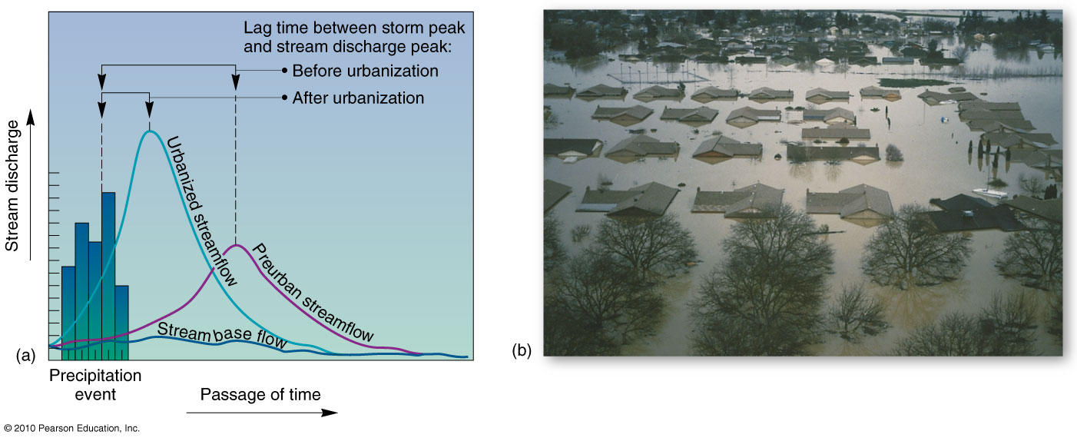
Urban Flooding
Figure 11.31

Slide 52
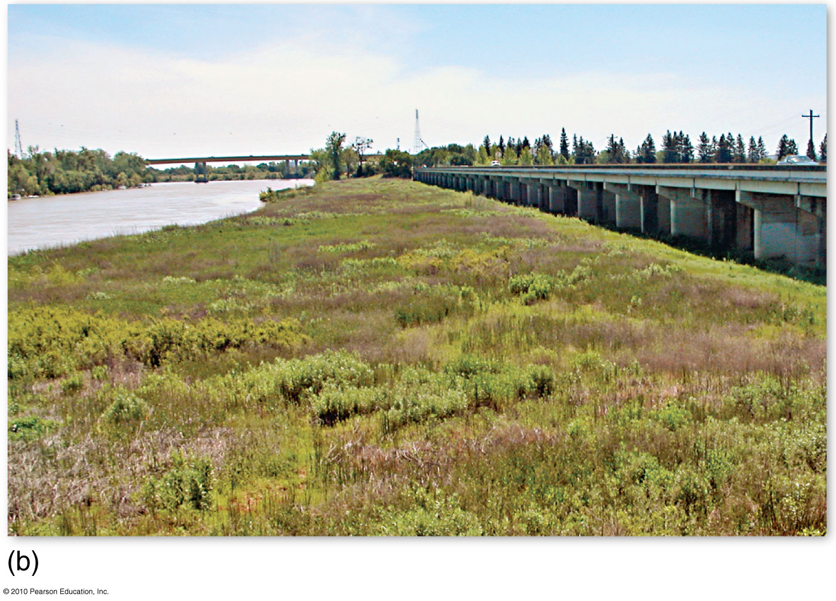

Weir and Bypass Channel
Figure 11.1.1

Slide 53
End of Lecture
Next Lecture Chapter 12

